Slide 1

Predicting Political Lean in U.S. Political News Text
Using a Convolutional Neural Net with GloVe Vector Representation of Words
Submitted in Partial Fulfillment of the Requirements for Data Analytics and Engineering 690
George Mason University | Volgenau School of Engineering
Spring 2019
“Brain image” downloaded from Quora, March 9, 2019
https://www.quora.com/Where-should-I-start-learning-Machine-Learning-Deep-Learning

Slide 2


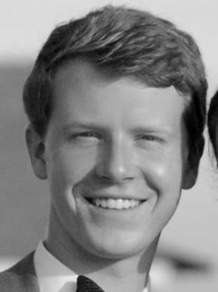



The Team
Predicting Political Lean in U.S. Political News Text | Spring 2019
David Wilbur
dwilbur@gmu.edu
Jake Whalen
twhalen3@gmu.edu
Paul Brinegar
pbrinega@gmu.edu
Joseph Huang
jhuang16@gmu.edu
Russell
Zimmermann
rzimme12@gmu.edu
Brinegar, Huang, Whalen, Wilbur, Zimmermann

Slide 3
Acknowledgements
Predicting Political Lean in U.S. Political News Text | Spring 2019
The George Mason University faculty and staff
Dr. Emily Vraga, Associate Professor, Department of Communication, GMU
Dr. Özlem Uzuner, Associate Professor, Information Sciences and Technology, GMU
Dr. Daniel Tamul, Assistant Professor, Department of Communication, VT
Dr. Keith Littlefield, SAIC
Finally, we would be remiss if we did not acknowledge the significant role that our families played in enabling our academic success. Their support and sacrifice over the last three years helped lift us all
Brinegar, Huang, Whalen, Wilbur, Zimmermann

Slide 4
Predicting Political Lean in U.S. Political News Text | Spring 2019
Motivation
Our Project
Definitions
Related work
Introduction
Dataset
Conditioning
Quality
Exploratory Analysis
Data
Neural Network
Processing Environ
Training Results
Test Results
Additional Analysis
Analysis
Conclusions
Conclusions
Lessons Learned
Future work

Slide 5
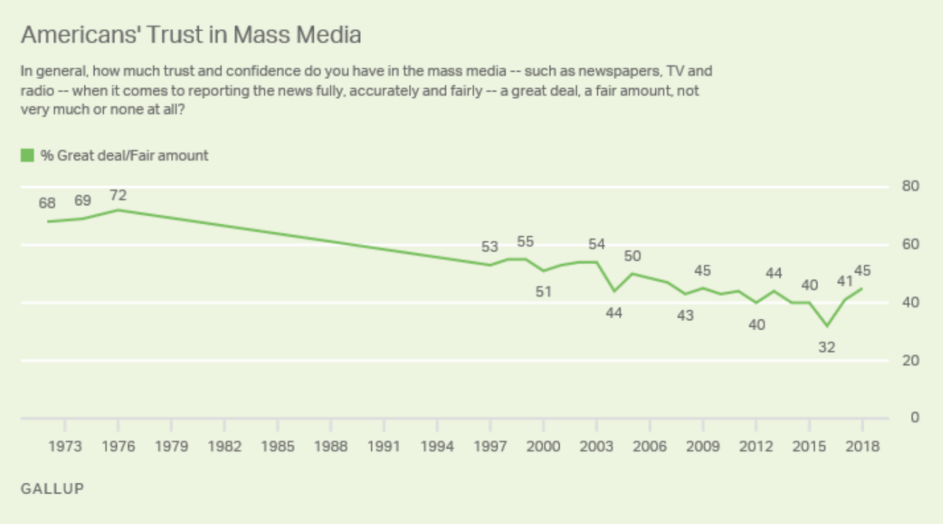
Predicting Political Lean in U.S. Political News Text | Spring 2019
Motivation
Our Project
Definitions
Related work
Introduction
“most Americans believe it is now harder to be well-informed and to determine which news is accurate. They increasingly perceive the media as biased and struggle to identify objective news sources. They believe the media continue to have a critical role in our democracy but are not very positive about how the media are fulfilling that role.”
“I have yet to see a piece of writing, political or non-political, that does not have a slant. All writing slants the way a writer leans, and no man is born perpendicular.” - E. B. White
Brinegar, Huang, Whalen, Wilbur, Zimmermann

Slide 6
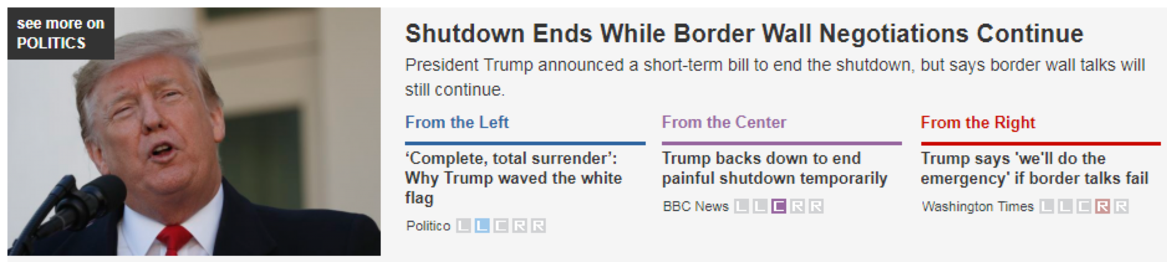
Predicting Political Lean in U.S. Political News Text | Spring 2019
Motivation
Our Project
Definitions
Related work
Introduction
Political lean classification at the article level using GloVe word embedding and Convolutional Neural Network (CNN)
Source: https://www.allsides.com/unbiased-balanced-news; 1/26/2019
Factors we are not going to address:
social and economic aspects
omission of facts and opinions
validity of facts and opinions
sentiment of the journalists and media outlets
political leaning of the journalists
Brinegar, Huang, Whalen, Wilbur, Zimmermann

Slide 7
Predicting Political Lean in U.S. Political News Text | Spring 2019
Motivation
Our Project
Definitions
Related work
Introduction
We found no universally accepted definition of bias. In communication theory bias is achieved through:
Omission, excluding of relevant information that disproves the desirable position and/or proves the other side
Placement, prominently displaying supportive stories for the desirable position and/or burying those for the other side
Selection of sources, including more sources supportive of the desirable position
Definition of leaning:
A tendency to present ideas with an emphasis on a particular political point of view
Brinegar, Huang, Whalen, Wilbur, Zimmermann

Slide 8
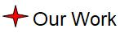
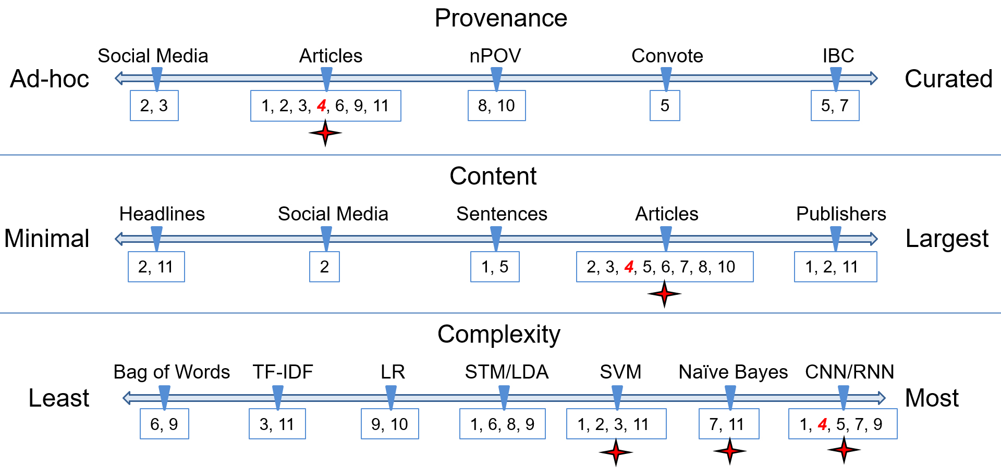
Predicting Political Lean in U.S. Political News Text | Spring 2019
Motivation
Our Project
Definitions
Related work
Introduction
Brinegar, Huang, Whalen, Wilbur, Zimmermann
Notes:
1 Bellows, Martha R. “Exploration of Classifying Sentence Bias in News Articles with Machine Learning Models.” University of Rhode Island, 2018.
2 Conner-Simons, Adam. “Detecting Fake News at Its Source.” MIT News, 4 Oct. 2018, news.mit.edu/2018/mit-csail-machine-learning-system-detects-fake-news-from-source-1004.
3 Dehghan, Ali, et al. Predicting News Bias. University of Victoria, 2016, web.uvic.ca/~afyshe/dm_projs/news_bias_final_report.pdf.
4 Hassan, Abdalraouf. “Deep Neural Language Model for Text Classification Based on Convolutional and Recurrent Neural Networks.” University of Bridgeport, 2018.
5 Iyyer, Mohit, et al. “Political Ideology Detection Using Recursive Neural Networks.” Proceedings of the 52nd Annual Meeting of the Association for Computational Linguistics (Volume 1: Long Papers), 2014, doi:10.3115/v1/p14-1105.
6 Lucas, Christopher. “Computer-Assisted Text Analysis for Comparative Politics.” Political Analysis, 4 Feb. 2015, pp. 254–277.
7 Misra, Arkajyoti, and Sanjib Basak. “Political Bias Analysis.” Stanford University, cs224d.stanford.edu/reports/MisraBasak.pdf.
8 Patankar, Anish A., et al. “A Bias Aware News Recommendation System.” Samsung R&D Institute, https://arxiv.org/ftp/arxiv/papers/1803/1803.03428.pdf.
9 Rachez, Arnaud, and Rodrigo Castro. “Predicting Political Bias with Python – Linalgo – Medium.” Medium.com, Medium Corporation, 19 Oct. 2017,
10 Recasens, Marta, et al. “Linguistic Models for Analyzing and Detecting Biased Language.” Proceedings of the 51st Annual Meeting of the Association for Computational Linguistics,4 Aug. 2013, pp. 1650–1659.
11 Sholar, John M. and Glaser, Noa. “Predicting Media Bias in Online News.” Stanford University, 6 June, 2016, http://cs229.stanford.edu/proj2016spr/report/059.pdf.

Slide 9
Predicting Political Lean in U.S. Political News Text | Spring 2019
Motivation
Definitions
Our Project
Related work
Introduction
Dataset
Conditioning
Quality
Exploratory Analysis
Data
Neural Network
Processing Environ
Training Results
Test Results
Additional Analysis
Algorithms
Conclusions
Conclusions
Lessons Learned
Future work
Notes:
So lets move onto the substance of our presentation.
I am going to walk you through our topic, explain the presentation, provide some definitions, and finally talk about some related work
Jake will introduce our dataset, some exploratory data analysis and conditioning steps
Paul will walk you through the algorithms we used
Joe will walk you through our results
And finally Russ will talk about the usefulness of CNNs, RNNs, and LSTM techniques in text classification and talk about future work

Slide 10
Predicting Political Lean in U.S. Political News Text | Spring 2019
Dataset
Conditioning
Quality
Exploratory Analysis
Data
The Hyperpartisan News Detection dataset originated from the PAN @ SemEval 2018 Task 4: Hyperpartisan News Detection challenge. The dataset consists of two distinct datasets:
The first dataset consists of 645 articles, with 238 (37%) hyperpartisan and 407 (63%) non-hyperpartisan records. This dataset is labeled (hyperpartisan true/false) through crowdsourcing on an article basis.
The second dataset consists of 750,000 articles, which are assigned labels at the source level by BuzzFeed and Media Bias/Fact Check (MBFC)
600,000 training articles / 150,000 test articles
Sources in training and test sets are mutually exclusive
Brinegar, Huang, Whalen, Wilbur, Zimmermann
Notes:
We searched for data labelled by political leaning (left, center, right) at the article level; had little luck
Came across competition on PAN where goal is to predict if a news article is hyperpartisan
Competition had 2 datasets
First consisted of 645 articles
Hyperpartisan article labels (not leaning)
Labels obtained through crowdsourcing (not us)
The 5 of us further labeled data to five point scale for leaning (left to right)
Both crowdsource and our own ratings resulted in a highly imbalanced dataset
Imbalance of the 645 articles, ~50% were least/center
Talk about why we used articles labeled at the publisher level
Evidence based on literature review and related work that also did by publisher, mixed results
Lack of a large enough, labeled dataset at the article level for using a neural network
Assumed law of large numbers, if labelled right majority of articles will represent a right leaning pov

Slide 11
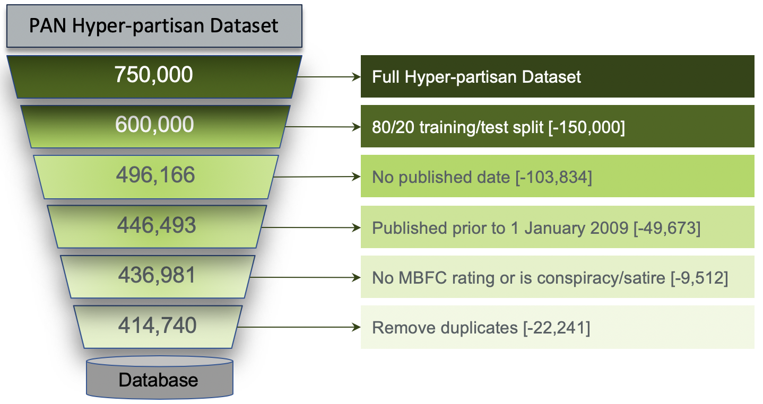
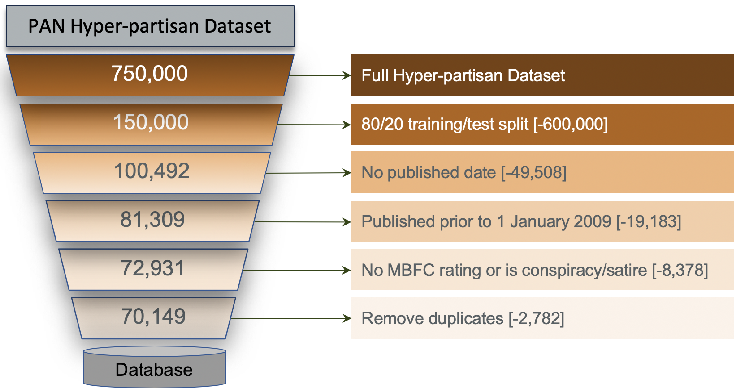
Predicting Political Lean in U.S. Political News Text | Spring 2019
Dataset
Conditioning
Quality
Exploratory Analysis
Data
Training & Validation
Test
Brinegar, Huang, Whalen, Wilbur, Zimmermann
Notes:
Data required a little cleanup to remove articles, we did not clean the article text
Data was split between train and test set already by the competition site
We chose a few filters that reduced the overall number of articles
Wanted to keep leaning on a topic consistent, political groups change over time
Removed articles with a missing publisher date
Removed articles that were published prior to Jan 1 2009
MBFC cited in multiple literature reviews
Therefore we made sure all of the ratings in the dataset matched MBFC rating for the publisher.
Dropped any that did not have an MBFC rating or were rated as something other than a political leaning (conspiracy/satire)
Last step was to drop duplicate articles based on article text field

Slide 12
Predicting Political Lean in U.S. Political News Text | Spring 2019
Dataset
Conditioning
Quality
Exploratory Analysis
Data
Quality Metric | Rating | Comments
Completeness | Complete | Data set complete with little to no missing values
Balance | Balanced | 5 Political Leaning Categories evenly distributed between left and right
Relevancy | Mostly Relevant | Non-political articles do exist in the dataset
Lineage/Pedigree | Understood | Content originates from actual news organizations
Label Accuracy | Mostly Accurate | Multiple related works referenced MBFC for their political leaning tagging source; labeled by publisher not individual article
Logical Consistency | Consistent | There are no duplicates in the data. There is a one-to-one relationship between article id and textual content
Quality Metric | Rating
Overall Quality
Brinegar, Huang, Whalen, Wilbur, Zimmermann
Notes:
Next we assessed the resulting datasets using 6 quality metrics
Completeness: are there alot of missing values?
Balance: how were the articles distributed across the 5 learning categories
Relevancy: were the articles focused on political topics? are they coming from US sources?
Lineage/Pedigree: are these legitimate articles from the publishers listed in the URL field?
Label Accuracy: how accurate are the political leanings for each article?
Logical consistency: are there duplicates? Oddities in the dataset that don’t make logical sense?
Overall we felt good about this dataset and our assumptions on the way it was labelled

Slide 13
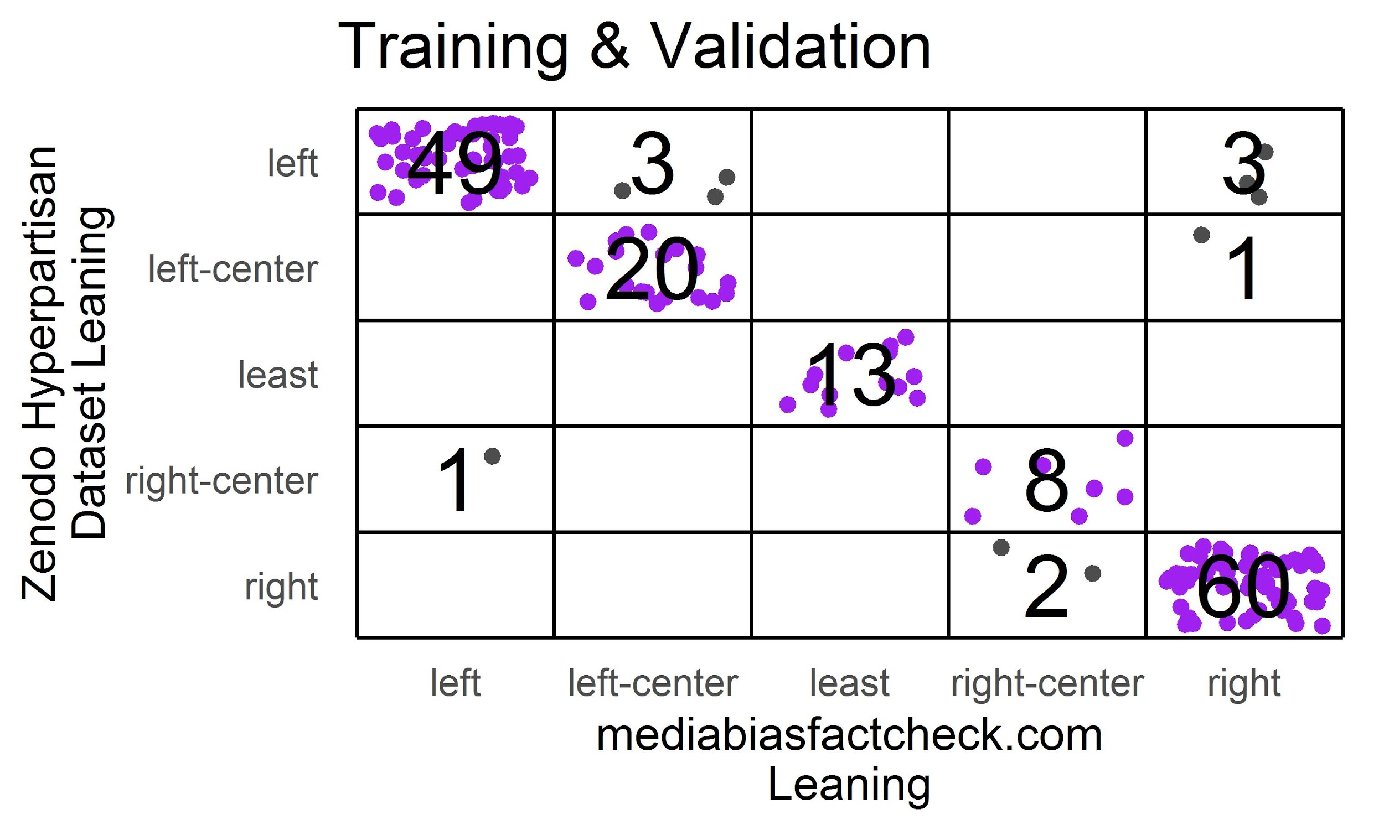
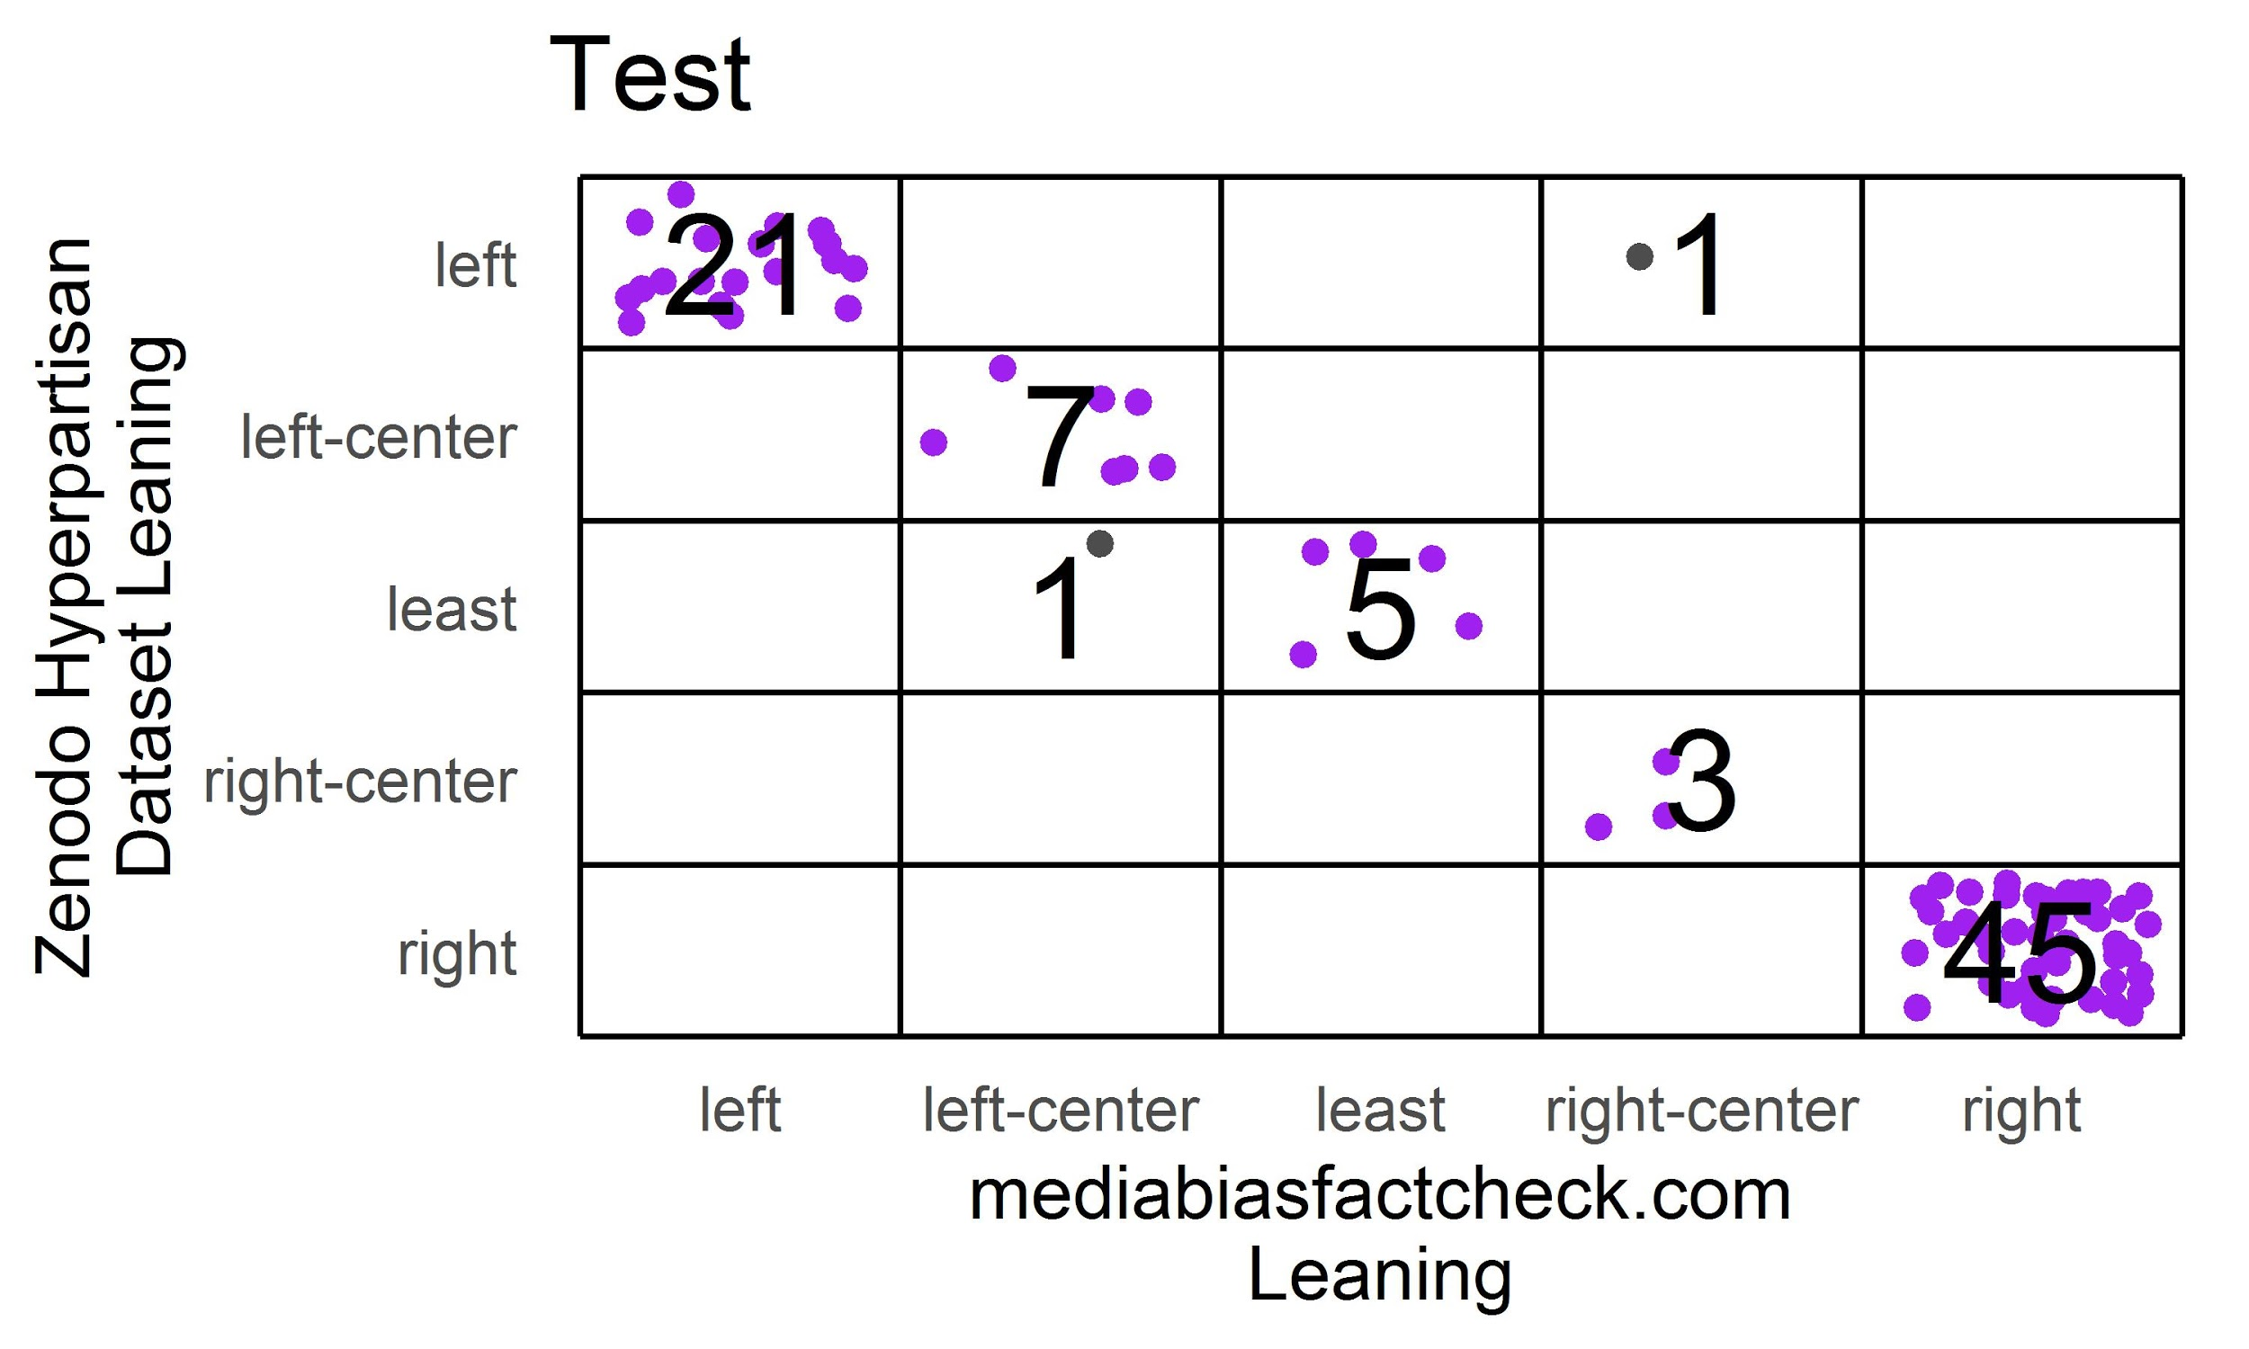
Predicting Political Lean in U.S. Political News Text | Spring 2019
Dataset
Conditioning
Quality
Exploratory Analysis
Data
Leaning Agreement with MBFC
Brinegar, Huang, Whalen, Wilbur, Zimmermann
Notes:
The following plots contain the training & validation data in the left plot and test data in the right
The plots show the agreement in source leaning between what was in the hyperpartisan dataset (y) and MBFC (x)
Overall strong agreement between the two as expected
Team chose to use MBFC leaning where disagreement occurred

Slide 14
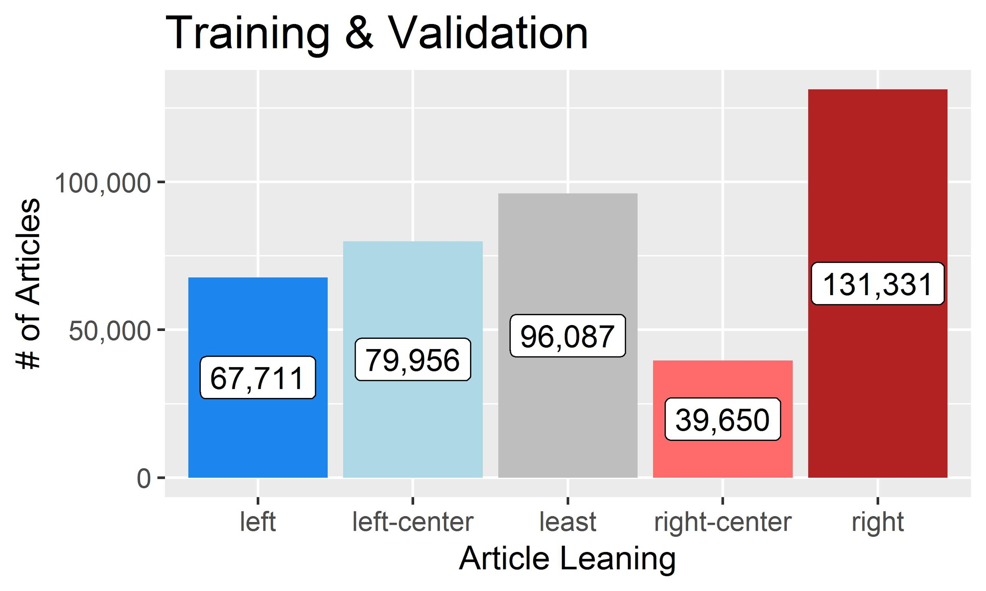
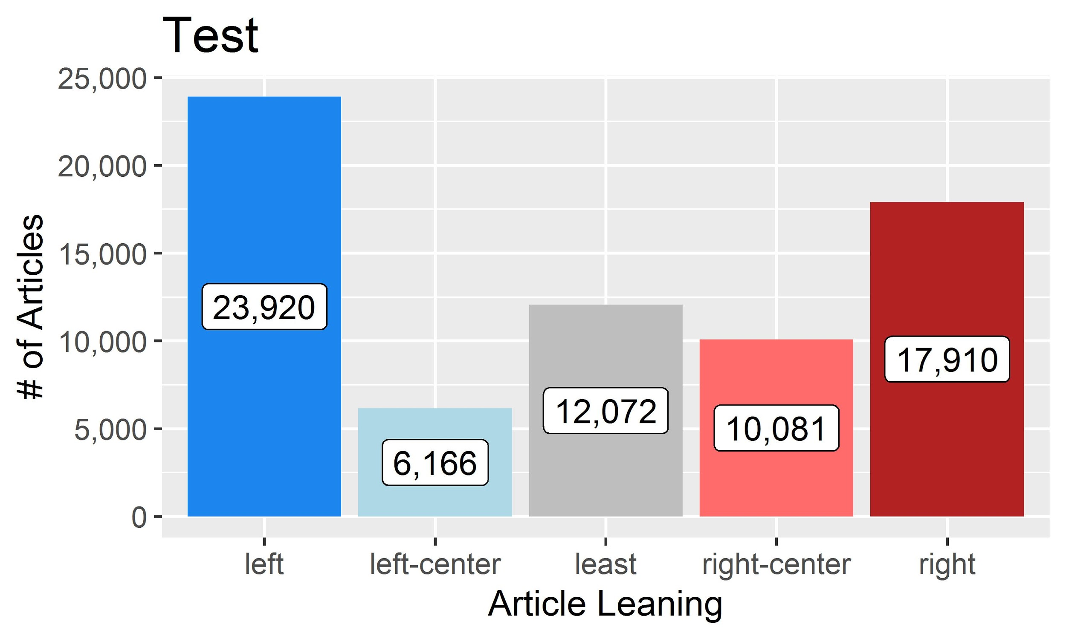
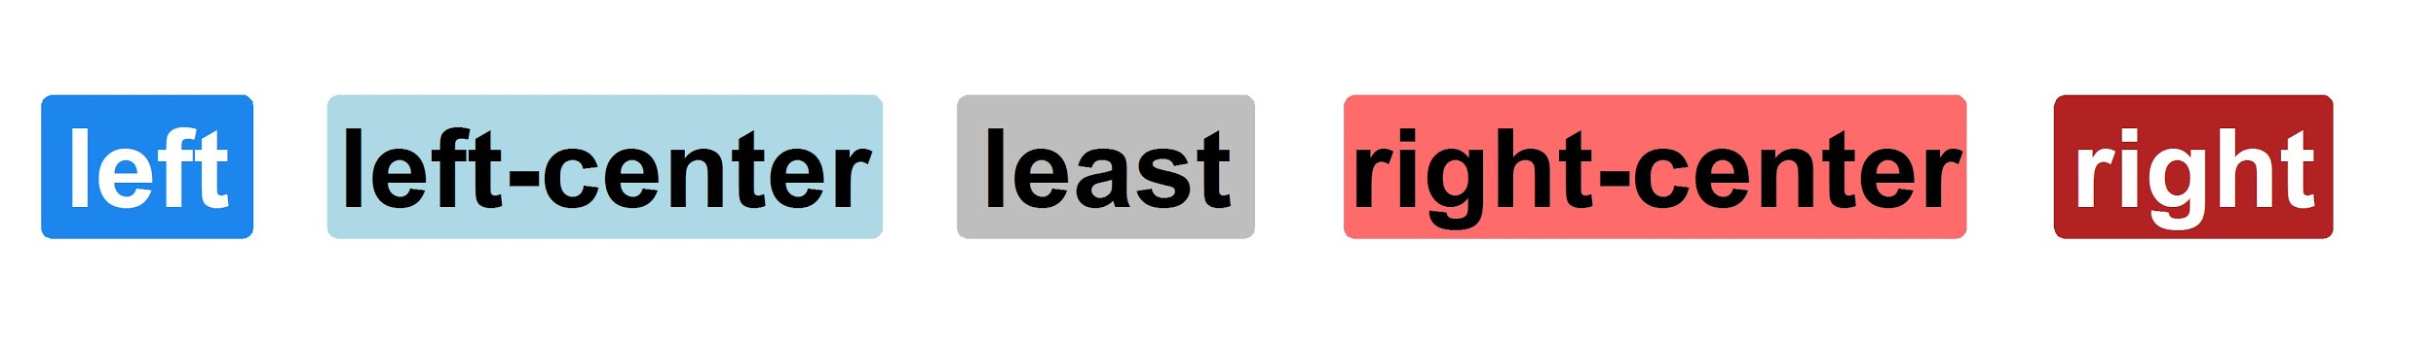
Predicting Political Lean in U.S. Political News Text | Spring 2019
Dataset
Conditioning
Quality
Exploratory Analysis
Data
Political Leaning
Brinegar, Huang, Whalen, Wilbur, Zimmermann
Notes:
Plots show distribution of articles across the 5 learning categories
Prior to removing some articles the distributions were perfectly even
After removal there were still a large enough number of articles that imbalance won’t be an issue

Slide 15
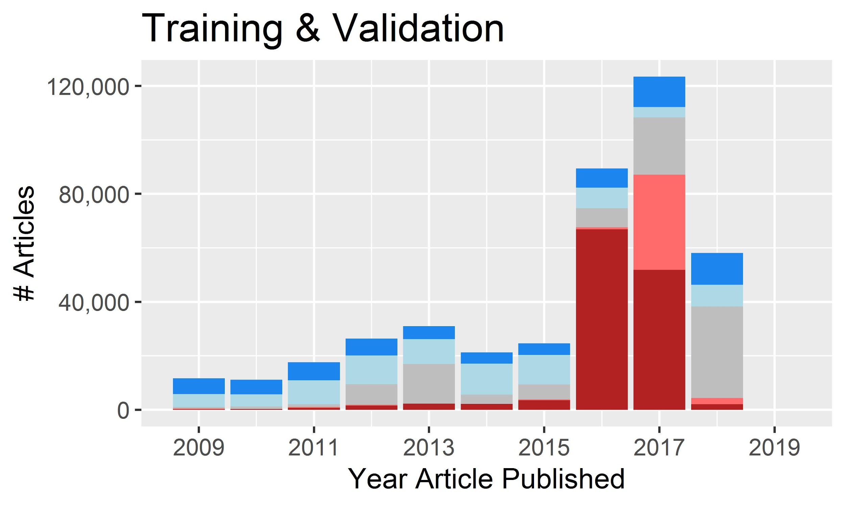
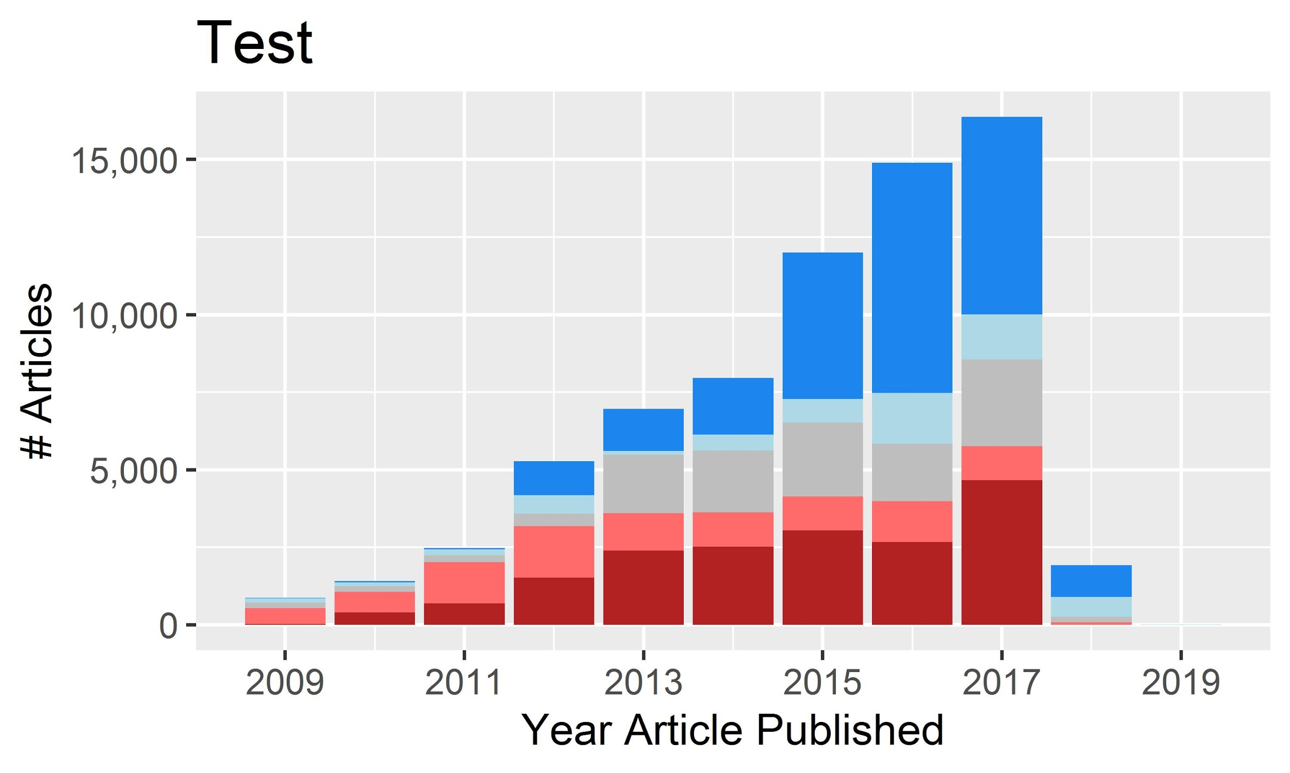
Predicting Political Lean in U.S. Political News Text | Spring 2019
Dataset
Conditioning
Quality
Exploratory Analysis
Data
Article Published Year
Brinegar, Huang, Whalen, Wilbur, Zimmermann
Notes:
Here the plots show the count of articles per year by leaning
A majority of articles were published in the last 4-5 years

Slide 16
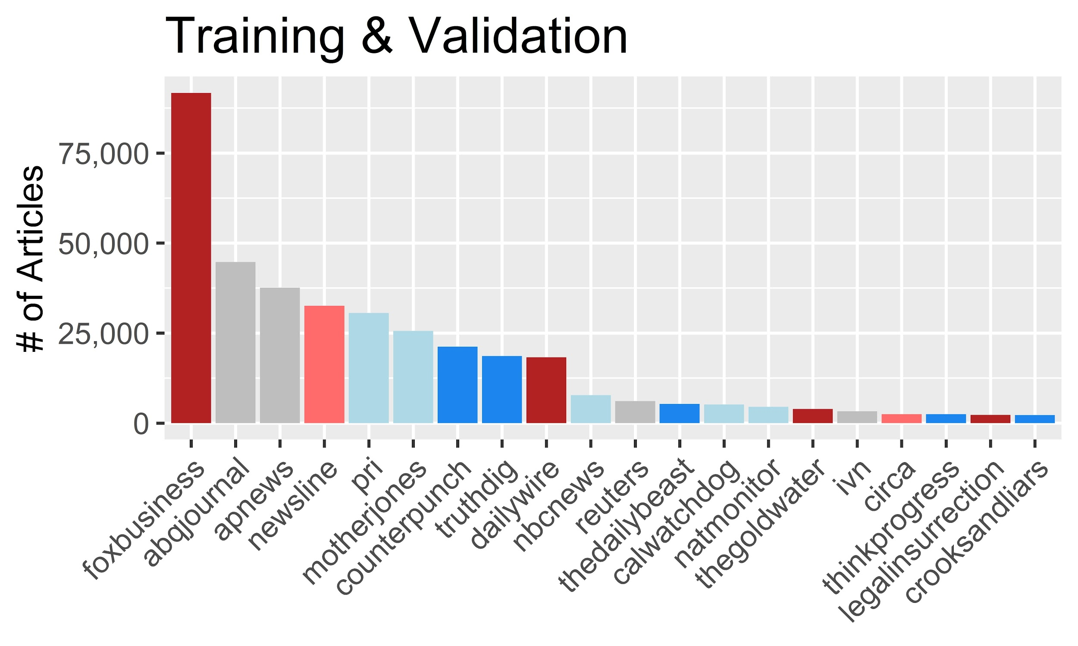
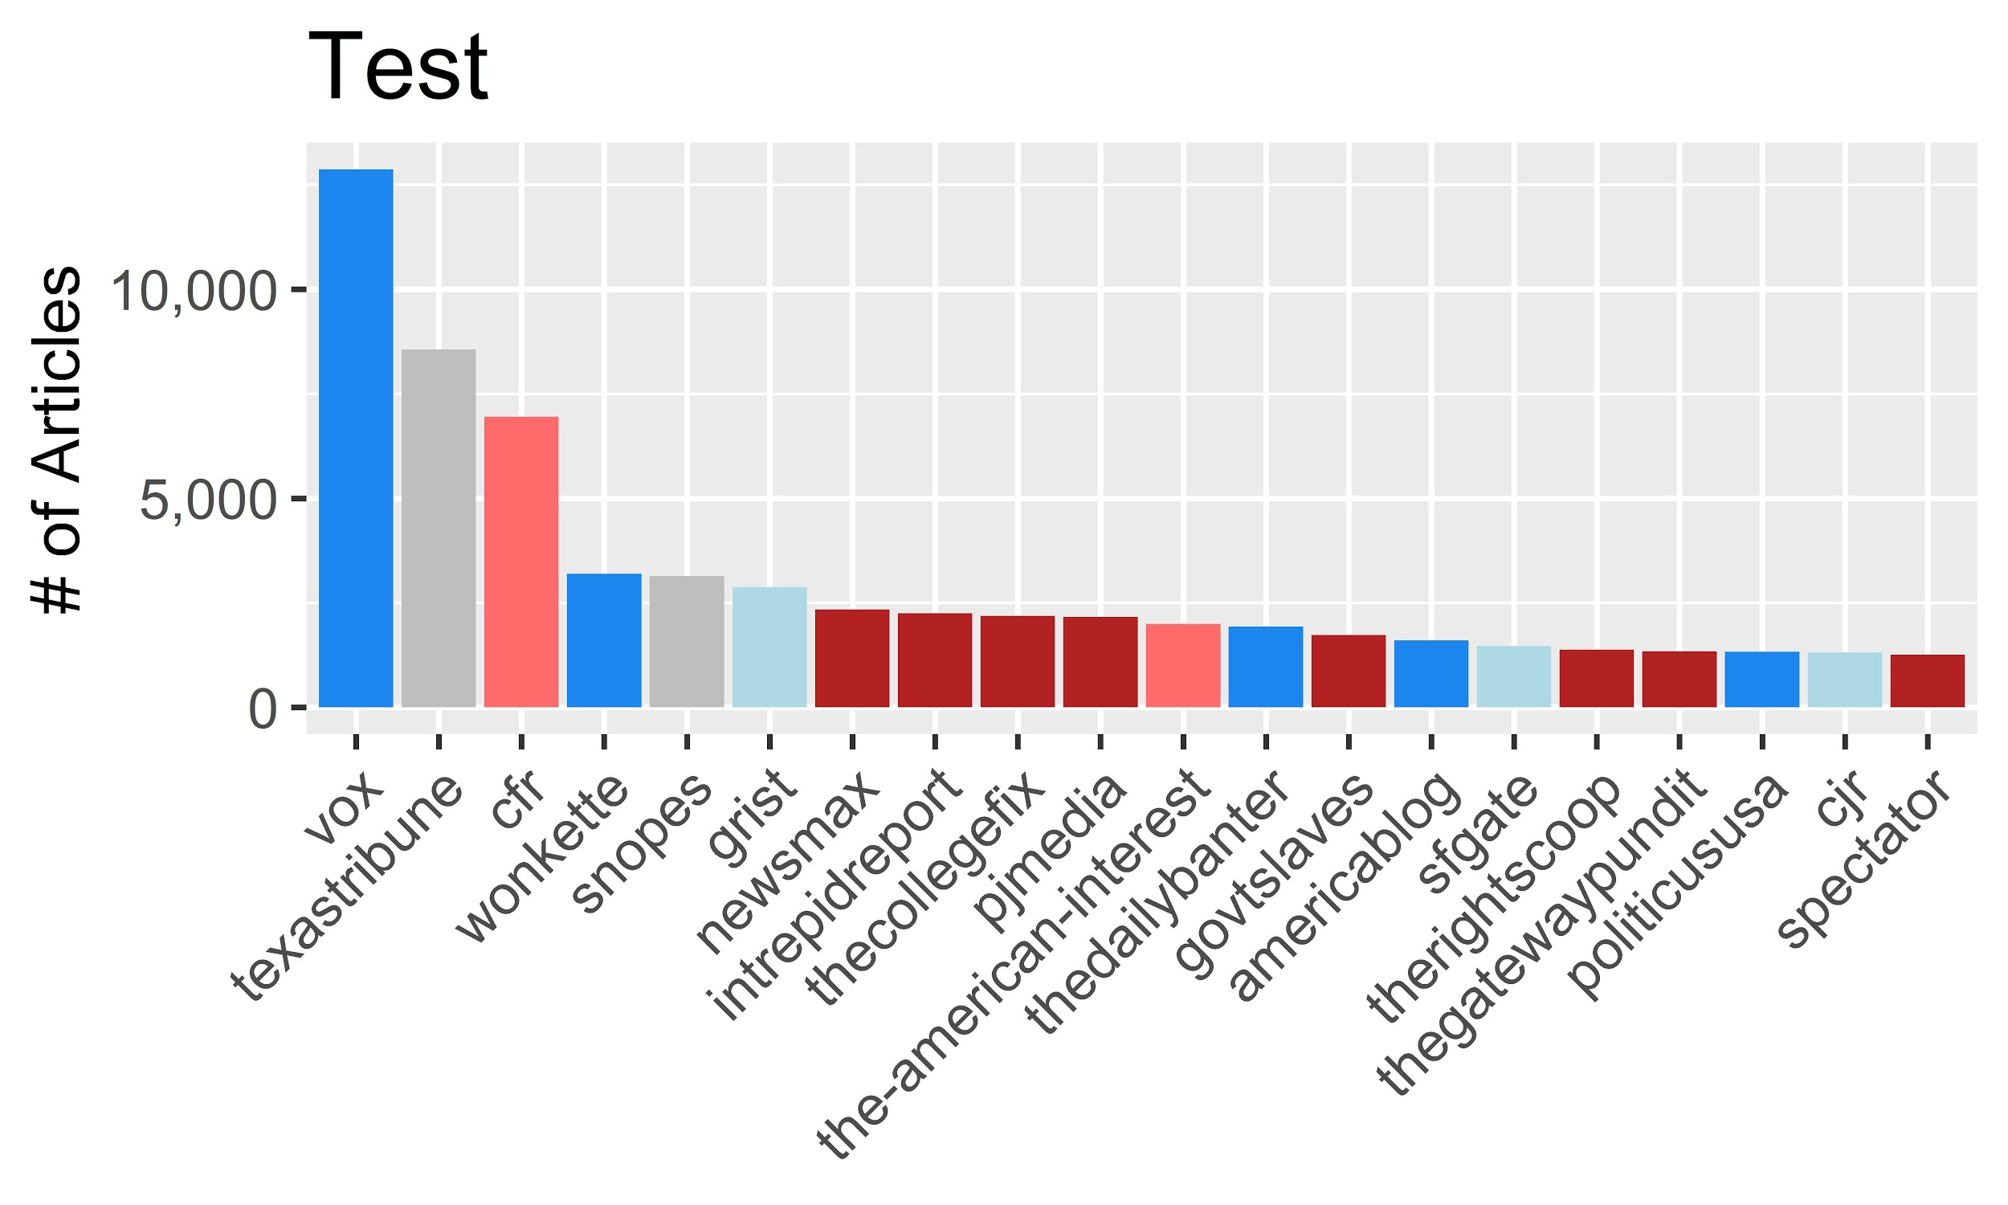
Predicting Political Lean in U.S. Political News Text | Spring 2019
Dataset
Conditioning
Quality
Exploratory Analysis
Data
Top 20 Sources
Brinegar, Huang, Whalen, Wilbur, Zimmermann
Notes:
plots show top 20 publishers
Few publishers contribute a lot of articles and a lot of publishers contribute few articles

Slide 17
Predicting Political Lean in U.S. Political News Text | Spring 2019
Motivation
Definitions
The project
Related work
Introduction
Dataset
Conditioning
Quality
Exploratory Analysis
Data
Neural Network
Processing Environ
Training Results
Test Results
Additional Analysis
Analysis
Conclusions
Conclusions
Lessons Learned
Future work
Notes:
So lets move onto the substance of our presentation.
I am going to walk you through our topic, explain the presentation, provide some definitions, and finally talk about some related work
Jake will introduce our dataset, some exploratory data analysis and conditioning steps
Paul will walk you through the algorithms we used
Joe will walk you through our results
And finally Russ will talk about the usefulness of CNNs, RNNs, and LSTM techniques in text classification and talk about future work

Slide 18
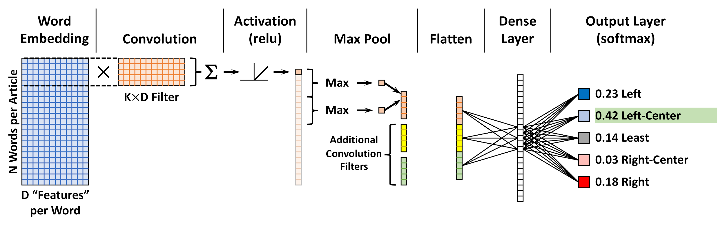
Predicting Political Lean in U.S. Political News Text | Spring 2019
Neural Network
Processing Environ
Training Results
Test Results
Additional Analysis
Analysis
Brinegar, Huang, Whalen, Wilbur, Zimmermann

Slide 19

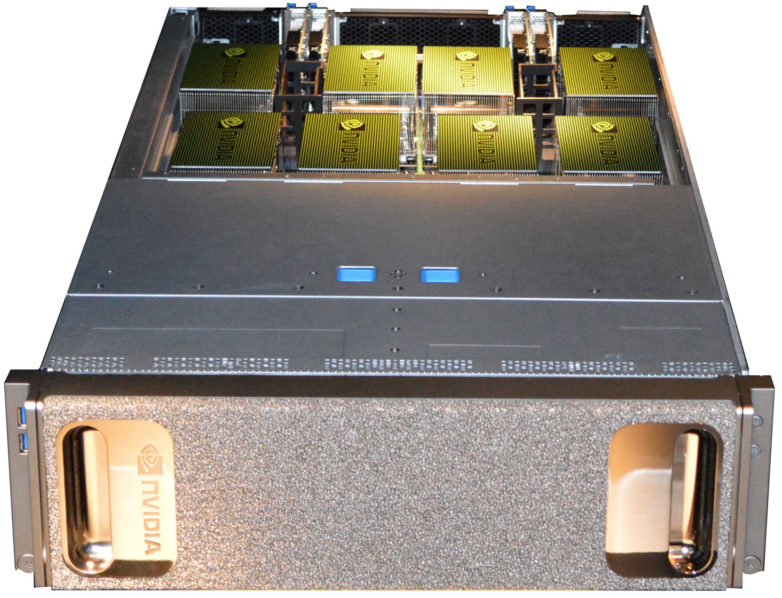

Predicting Political Lean in U.S. Political News Text | Spring 2019
Neural Network
Processing Environ
Training Results
Test Results
Additional Analysis
Analysis
Platform | Specifications | Purpose
Macbook Pro | 2.6GHz dual-core Intel Core i5 processor 16GB RAM | Coding Testing Visualization
NVIDIA DGX-1 | 8 Tesla V100 GPUs 16GB RAM per GPU Dual 20-Core Intel Xeon CPUs 40,960 NVIDIA CUDA Cores 5,120 Tensor Cores | Tuning Training Testing
AWS m5.4xlarge | 2.5 GHz Intel Xeon Platinum 8175M-series processor 64GB RAM | Testing
Brinegar, Huang, Whalen, Wilbur, Zimmermann

Slide 20
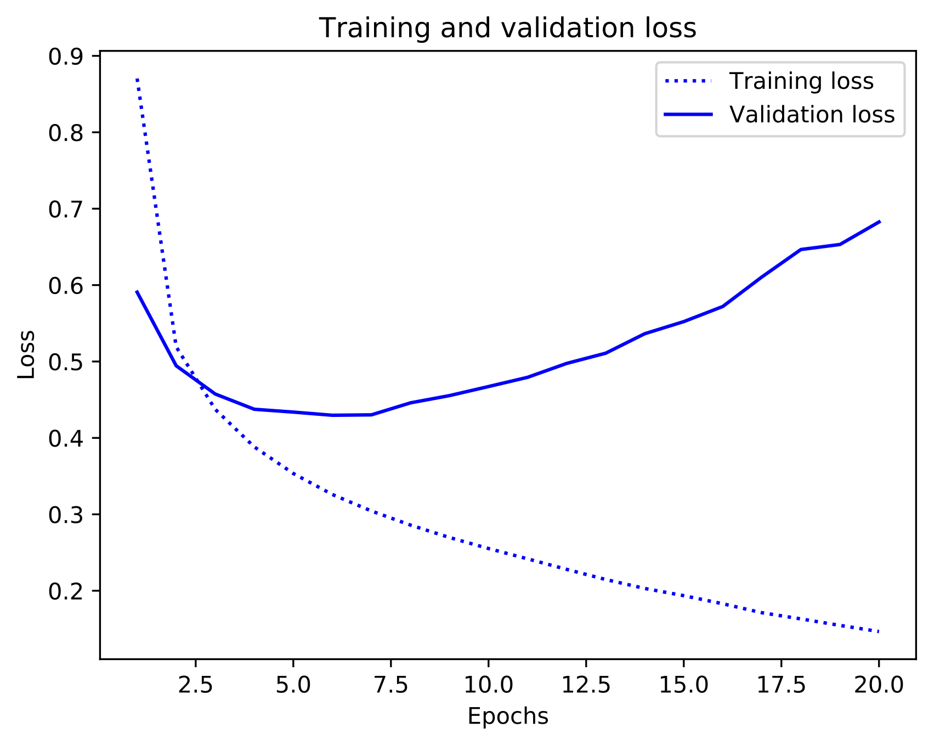
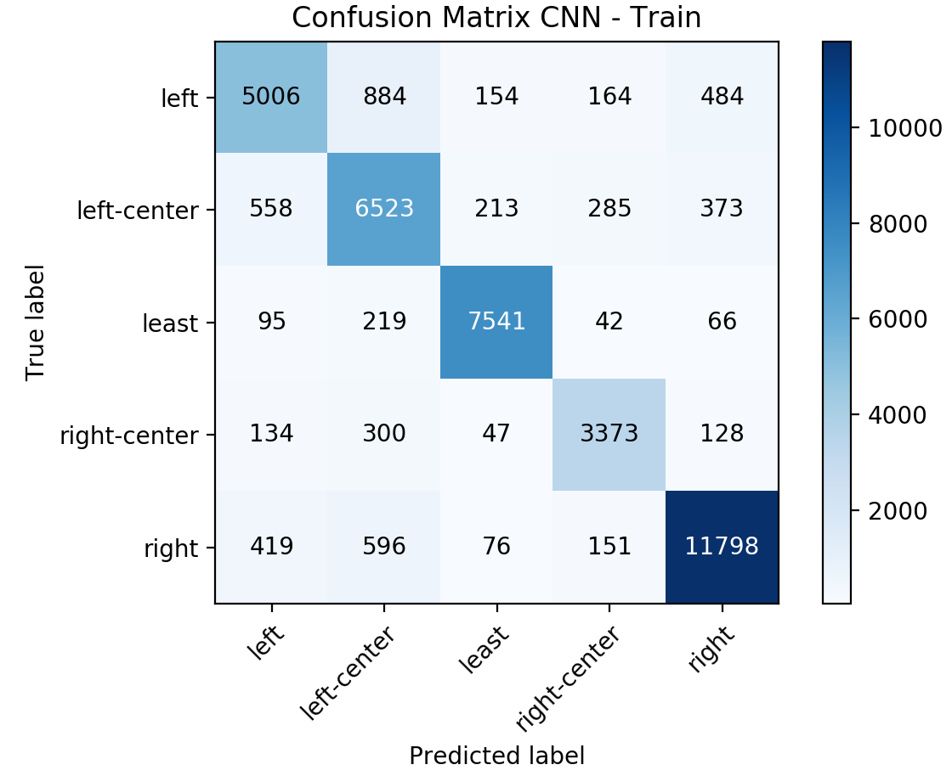
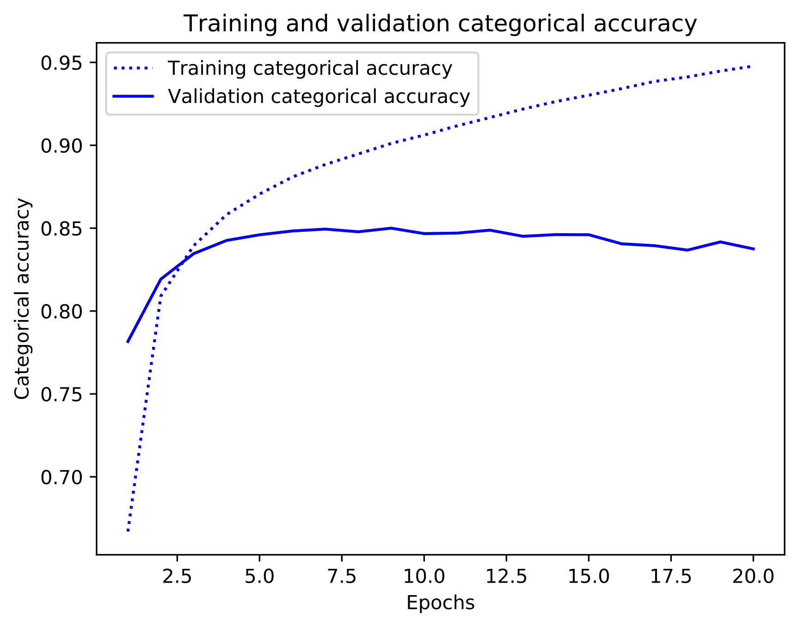
Predicting Political Lean in U.S. Political News Text | Spring 2019
Neural Network
Processing Environ
Training Results
Test Results
Additional Analysis
Analysis
Validation
Brinegar, Huang, Whalen, Wilbur, Zimmermann
Notes:
Hyperparameters (vocabulary size, maximum article length, number of convolution filters, convolution kernel size, pooling window size, number of dense layer units, dropout percentage, epochs, gradient descent method)
Results (overall accuracy, confusion matrix, F1, precision, recall)
Processing Time (laptop, AWS instance, DGX-1)

Slide 21
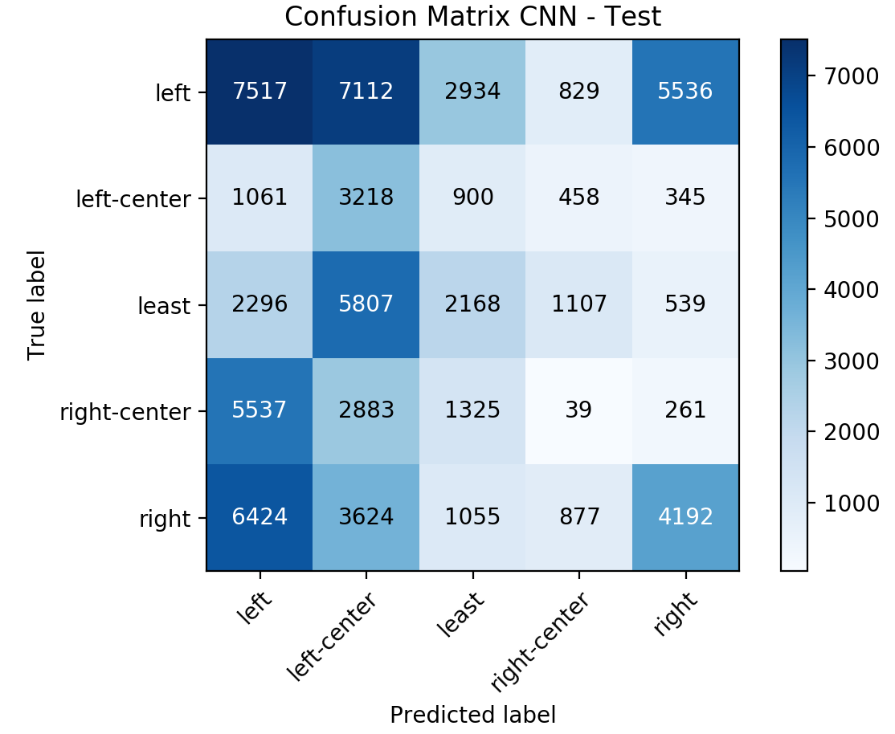
Predicting Political Lean in U.S. Political News Text | Spring 2019
Neural Network
Processing Environ
Training Results
Test Results
Additional Analysis
Analysis
Test
Brinegar, Huang, Whalen, Wilbur, Zimmermann

Slide 22

Predicting Political Lean in U.S. Political News Text | Spring 2019
Brinegar, Huang, Whalen, Wilbur, Zimmermann

Slide 23
Predicting Political Lean in U.S. Political News Text | Spring 2019
Neural Network
Processing Environ
Training Results
Test Results
Additional Analysis
Analysis
Suspected model was overfitting though we believed that overfitting would have shown up in our cross-validation results
Suspicion of the dataset, model is picking up on latent publisher style or structure
Shuffled the training and test data together, performed a new 80/20 train/test split and obtained mid-70% on this new test set. Which indicates that there given that the publishers are mutually exclusive between the datasets there is something in the data that is highly correlated to the publisher that our model is picking up on
Brinegar, Huang, Whalen, Wilbur, Zimmermann

Slide 24
Predicting Political Lean in U.S. Political News Text | Spring 2019
Neural Network
Processing Environ
Training Results
Test Results
Additional Analysis
Analysis
Attempts to make the model more general and break correlation with publisher
Feature Engineering
Removed words frequently used by specific publishers
Removed words that were highly correlated with specific leanings
Removed effects of ‘by-lines’ and ‘credit-lines’
Removed first and last M-words
Removed publishers with highly unique vocabularies
Changed publisher date cut-off
Model Engineering
Altered dimensionality of word embeddings
Added regularization
Attempted multi-layer sequential CNN
Attempted parallel CNN with different parameters for each
Result: No significant change in test accuracy
Brinegar, Huang, Whalen, Wilbur, Zimmermann

Slide 25
Predicting Political Lean in U.S. Political News Text | Spring 2019
Neural Network
Processing Environ
Training Results
Test Results
Additional Analysis
Analysis
Consulted with experts in the field
Rebalanced training dataset with equal number of publishers per leaning (20) and articles per publisher (100)
Attempted simpler model with three labels (Left, Least, Right) by:
Combining Left-Center, Least, and Right-Center
Combining Left with Left-Center and Right-Center with Right
Attempted an even simpler model with only two labels (true/false), hyperpartisan only
Result: No significant change in test accuracy
Considered using small (645 article) dataset labeled at the article level
Significantly imbalanced; balancing number of articles through sub-sampling resulted in too few articles remaining to obtain reasonable results.
Brinegar, Huang, Whalen, Wilbur, Zimmermann

Slide 26
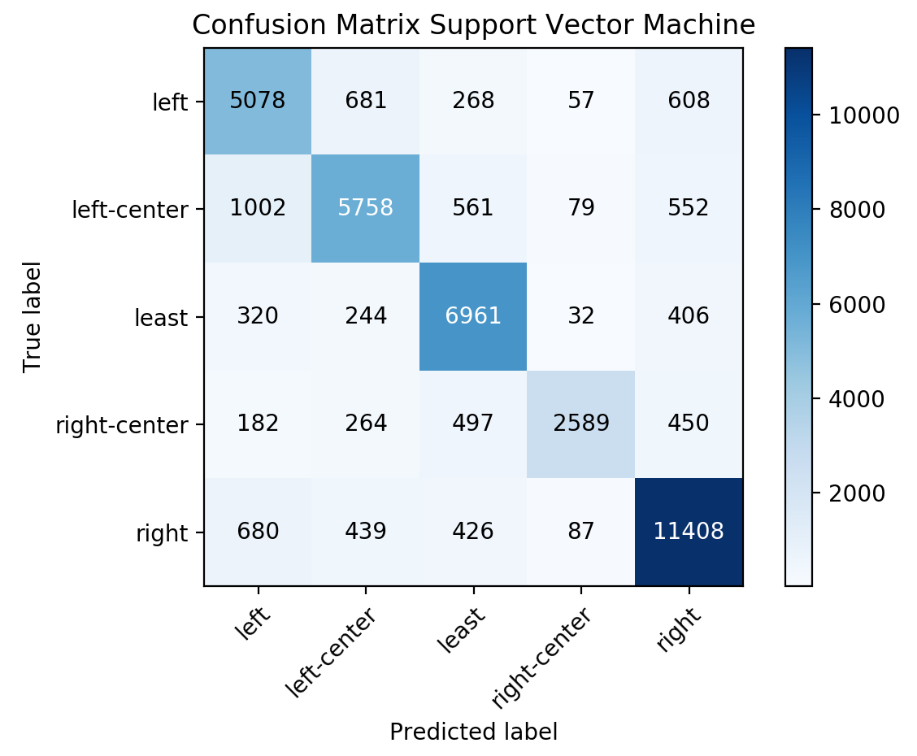
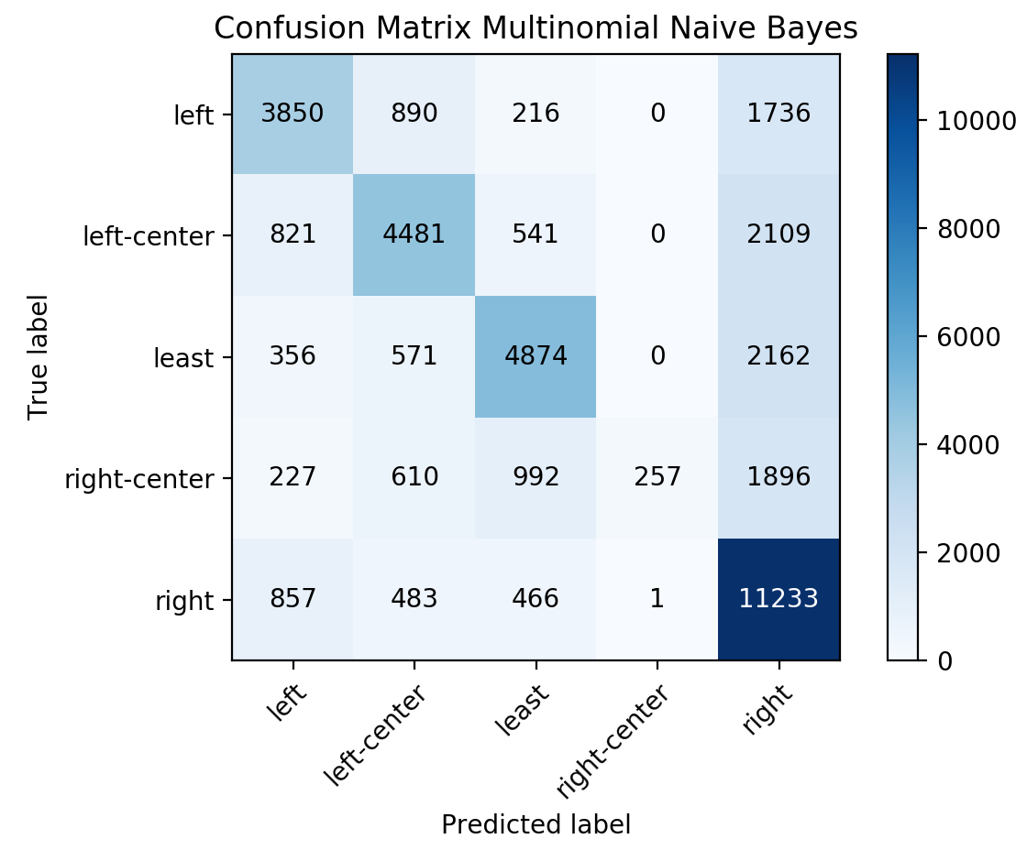
Predicting Political Lean in U.S. Political News Text | Spring 2019
Neural Network
Processing Environ
Training Results
Test Results
Additional Analysis
Analysis
Tried Support Vector Machine (SVM) and Multinomial Naive Bayes (MNB) to investigate test results and compare with CNN results
Similarly high accuracies on validation data (CNN 86%, SVM 80%, MNB 62%)
CNN
SVM
MNB
Brinegar, Huang, Whalen, Wilbur, Zimmermann

Slide 27
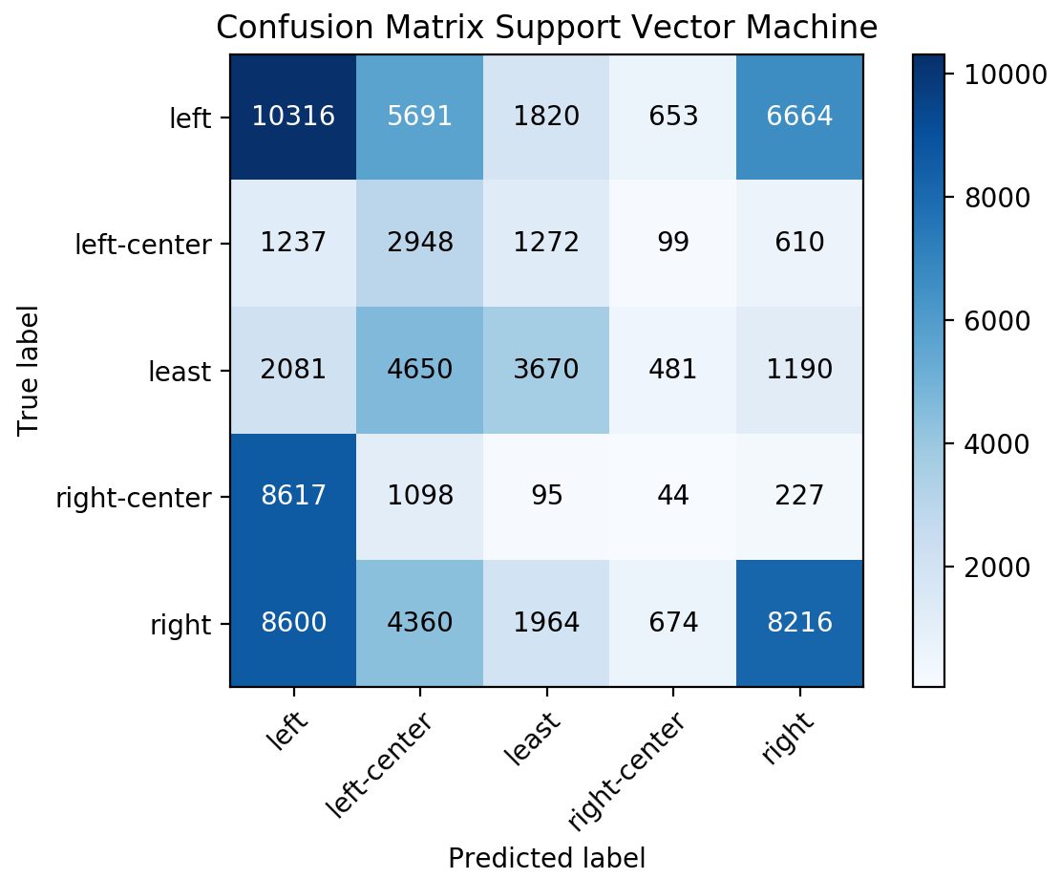
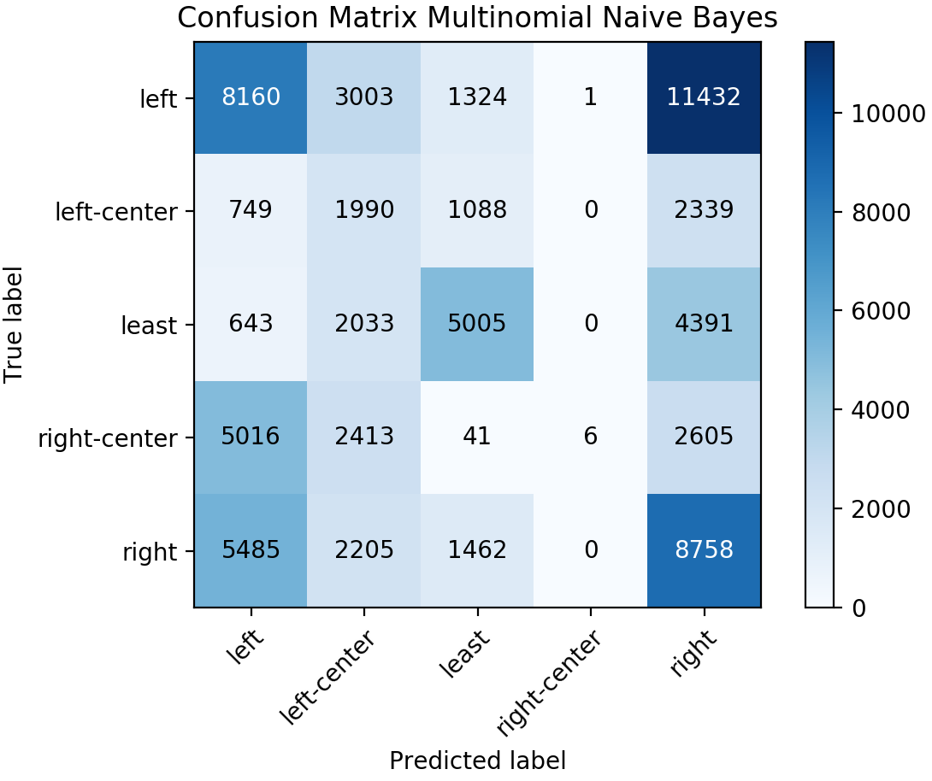
Predicting Political Lean in U.S. Political News Text | Spring 2019
Neural Network
Processing Environ
Training Results
Test Results
Additional Analysis
Analysis
But also low accuracies on the test data (CNN 25%, SVM 33%, MNB 34%)
CNN
SVM
MNB
The similar results from multiple models support the hypothesis that this dataset, labeled at the source level, yields low accuracies when predicting political leanings at the article level
Brinegar, Huang, Whalen, Wilbur, Zimmermann

Slide 28
Predicting Political Lean in U.S. Political News Text | Spring 2019
Motivation
Definitions
Our Project
Related work
Introduction
Dataset
Conditioning
Quality
Exploratory Analysis
Data
Our Neural Network
Processing Environ
Training Results
Test Results
Additional Analysis
Analysis
Conclusions
Conclusions
Lessons Learned
Future work
Notes:
So lets move onto the substance of our presentation.
I am going to walk you through our topic, explain the presentation, provide some definitions, and finally talk about some related work
Jake will introduce our dataset, some exploratory data analysis and conditioning steps
Paul will walk you through the algorithms we used
Joe will walk you through our results
And finally Russ will talk about the usefulness of CNNs, RNNs, and LSTM techniques in text classification and talk about future work

Slide 29
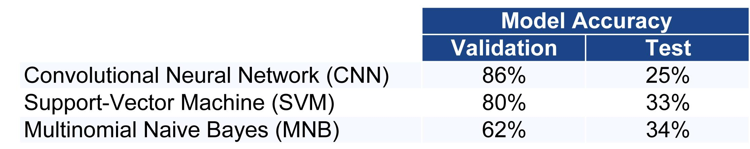
Predicting Political Lean in U.S. Political News Text | Spring 2019
Conclusions
Conclusions
Lessons Learned
Future work
Models accurately predict validation data labels
Models poorly predict test data labels
Feature engineering did not improve predictions
Model engineering did not improve predictions
Models applied to the Hyperpartisan News Detection dataset, labeled at the source level, achieved slightly better than random predictions at classifying political lean at the article level
Brinegar, Huang, Whalen, Wilbur, Zimmermann
Notes:
Summarize accuracies from CNN/MNB/SVM on dataset
Model did not generalize to the test set

Slide 30
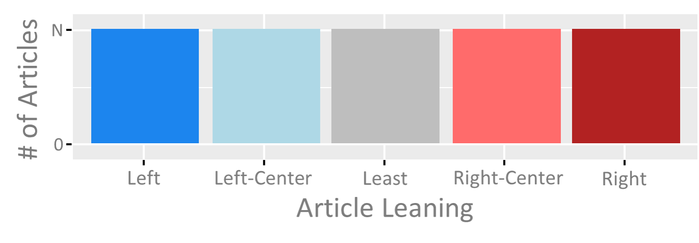
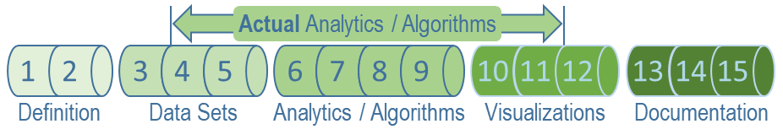
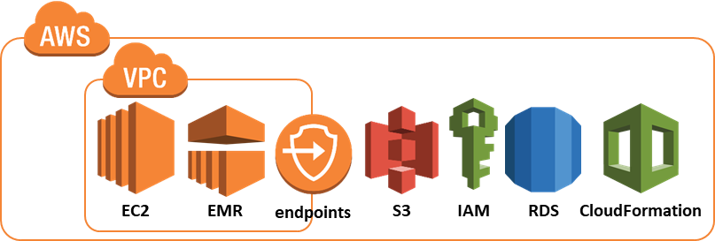
Predicting Political Lean in U.S. Political News Text | Spring 2019
Conclusions
Conclusions
Lessons Learned
Future work
Label dataset at the article level
Engage subject matter experts for project feasibility
Scale the compute environment early
Brinegar, Huang, Whalen, Wilbur, Zimmermann
Notes:
Lessons Learned
Dataset labeled at source level not appropriate for our intended use.
Dataset should be labeled at the article or sentence level
Run model on test data sooner, validation accuracy results not indicative of results on test data (did not fail soon enough)
If you can’t find data that fits pick a difference problem
Engage experts early.
NLP is processing intensive, plan ahead (AWS/AZURE) GPU compute early

Slide 31
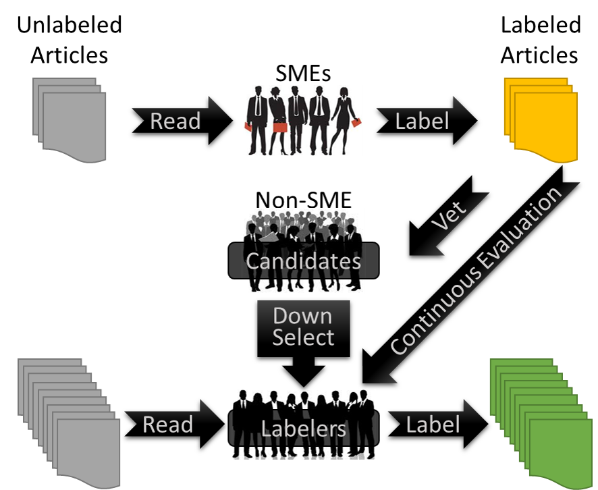
Predicting Political Lean in U.S. Political News Text | Spring 2019
Conclusions
Conclusions
Lessons Learned
Future work
Develop “gold standard” leaning labeled, article level dataset
By subject matters experts (SMEs)
Build out dataset to sufficient size
By non-SMEs, vetted using “gold standard” dataset
Explore additional analytic models
Recurrent Neural Network (RNN)
Long Short Term Memory (LSTM)
Reinforcement Learning
Transfer Learning
Attention based methods
Compare accuracy and performance of analytic models
Brinegar, Huang, Whalen, Wilbur, Zimmermann
Notes:
Voice track: discuss what this would take
Skill set required to do the first bullet
subject matter expertise in ‘leaning’ labeling
This is not feasible for a team of 5 people for a single semester
Multiple teams (5 or more) may get through enough to analyze
If a gold standard data set were created it would need to be updated every so many years to ensure it keeps up with the current political climate.
The “nuclear” option in the Senate is an example of whether or not a pro or con argument for it is left or right leaning
Identify “labelers” that score highly on labeling the “gold standard” datasets
Future Work
Spend a semester curating an ideal ‘leaning’ dataset (mechanical turk, etc…)
Look at sentence/paragraph methods to labeling
Identify sentences that do not contribute to the leaning
Explore RNN, LSTM, reinforcement learning, transfer learning, attention based methods
Once you figure out the issues, compare cost benefit of difference models

Slide 32
Predicting Political Lean in Textual U.S. News Reporting | Spring 2019
Predicting Political Lean in U.S. Political News
Backup Slides
Brinegar, Huang, Whalen, Wilbur, Zimmermann

Slide 33
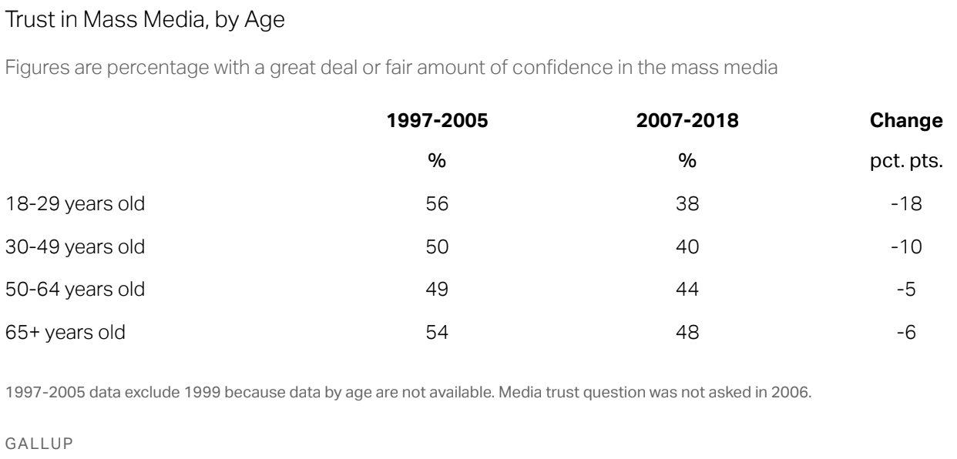
Predicting Political Lean in U.S. Political News Text | Spring 2019
Motivation
Definitions
Our Project
Related work
Introduction
Brinegar, Huang, Whalen, Wilbur, Zimmermann
Notes:
Era where Americans continue to redefine their relationship with the news media
Decreasing trust in the mass media isn’t a contemporary phenomenon, according to Gallup Americans’ trust in Mass Media has declined since 1972’
Also according to Gallup, Americans’ struggle to identify objective news sources.
And finally, E.B. White in his 1956 Essay ‘Bedfellows’ Says….

Slide 34
Major Biases, Generally Defined
Predicting Political Lean in U.S. Political News Text | Spring 2019
Motivation
Definitions
Our Project
Related work
Introduction
Memory: Representativeness, Availability, Imaginability, and Illusory correlation
Statistical: Conjunction, Disjunction, and Sample
Confidence: Desire and Selectivity
Adjustment/Anchoring: Partition dependence, Conservatism, and Regression
Motivational
Clemen, Robert T., and Terence Reilly. Making Hard Decisions with DecisionTools®. South-Western, Cengage Learning, 2014
Brinegar, Huang, Whalen, Wilbur, Zimmermann
Notes:
should we discuss media bias in general, and the many factors that goes into the assessment of a media bias label?
<<<maybe cite some info from MBFC since that’s a source of our dataset’s labels>>>

Slide 35
Media Biases Specifically Defined From Media Bias/Fact Check
Predicting Political Lean in U.S. Political News Text | Spring 2019
Motivation
Definitions
Our Project
Related work
Introduction
Omission
Labeling
Placement
Selection of Sources
Spin
Story Selection
Confirmation Bias
Connotation
Denotation
Loaded Language (Words)
Purr Words
Snarl Words
Other factors to look for
Do the headlines and stories match?
Are important stories featured prominently?
Does the story offer an alternative point of view?
https://mediabiasfactcheck.com/methodology
Brinegar, Huang, Whalen, Wilbur, Zimmermann
Notes:
should we discuss media bias in general, and the many factors that goes into the assessment of a media bias label?
<<<maybe cite some info from MBFC since that’s a source of our dataset’s labels>>>

Slide 36
Media Bias to Political Leaning
Predicting Political Lean in U.S. Political News Text | Spring 2019
Motivation
Definitions
Our Project
Related work
Introduction
There is no universal definition of media bias. Evaluation of media bias may include assessments of:
what type of bias: social, economic, and political
inclusion/omission of facts and opinions
validity and veracity of facts and opinions
selection of terms/phrases/quotes and source materials
frequency and placement of topics and content
sentiment/leaning of the journalists and media outlets
A realistic determination of media bias would include many, if not all, of these factors.
Need to narrow project scope to focus on a select few factors. This is a limited interpretation of media bias, which can be called ‘Political Leaning’.
political bias
selection of terms/phrases/quotes and source materials
frequency and placement of topics and content
sentiment/leaning of the journalists and media outlets
Brinegar, Huang, Whalen, Wilbur, Zimmermann
Notes:
should we discuss media bias in general, and the many factors that goes into the assessment of a media bias label?
<<<maybe cite some info from MBFC since that’s a source of our dataset’s labels>>>

Slide 37
Political Leaning Working Definition
Predicting Political Lean in U.S. Political News Text | Spring 2019
Motivation
Definitions
Our Project
Related work
Introduction
A tendency to frame ideas with an emphasis on a particular political point of view through:
selection of terms/phrases/quotes and source materials
frequency and placement of topics and content
sentiment/leaning of the journalists and media outlets.
These are factors we are not going to address:
what type of bias: social and economic
inclusion/omission of facts and opinions
validity and veracity of facts and opinions
Brinegar, Huang, Whalen, Wilbur, Zimmermann

Slide 38
Assumptions
Predicting Political Lean in U.S. Political News Text | Spring 2019
Motivation
Definitions
Our Project
Related work
Introduction
Political leaning exists in news media
Only looking at english language articles
Media sources have historical, inherent corporate cultures of bias
Media sources have financial interests in pursuing a bias
Universal/accepted definition of political leaning
Machine learning can help identify leaning
Data is readily available within project timeline
Authoritative training set exists
Compute power exists to assess representative dataset within budget
Historical data is available
Only looking at articles written in 2009 or later
Focus on political articles, however other topics will be present
Brinegar, Huang, Whalen, Wilbur, Zimmermann

Slide 39
Predicting Political Lean in U.S. Political News Text | Spring 2019
Motivation
Definitions
Our Project
Related work
Introduction
Risk | Probability | Impact | Mitigations
Data is too big for our processing capabilities | High | Low | Take subset of data; use big data tools (Amazon Web Services)
Data integration of data from disparate sources | Medium | Medium | Limit data to single format; convert to standard format
Failure to obtain appropriate data | Low | High | Move to a known data source with defined API (e.g. Twitter)
Failure to obtain authoritative training data | Medium | High | Arbitrarily create training dataset; scrape data from websites that may not be authoritative
Analytic methods fail | High | Medium | Prototype early; apply multiple techniques; understand and document failures
Failure to succinctly define bias | Low | High | Define bias
Project scope creep | High | High | Spend time upfront defining the problem; identify the appropriate data source; use agile development methodology
Model only valid for trained date range | High | Low | Document the issue and list it as an opportunity for future research.
Brinegar, Huang, Whalen, Wilbur, Zimmermann

Slide 40
Useful References
Predicting Political Lean in U.S. Political News Text | Spring 2019
Motivation
Definitions
Our Project
Related work
Introduction
Swift, Art. “Americans' Trust in Mass Media Sinks to New Low.” Gallup.com, Gallup, Inc., 14 Sept. 2016, news.gallup.com/poll/195542/americans-trust-mass-media-sinks-new-low.aspx?version=print.
Patankar, Anish A., et al. “A Bias Aware News Recommendation System.” Samsung R&D Institute, https://arxiv.org/ftp/arxiv/papers/1803/1803.03428.pdf.
Wiggers, Kyle. “MIT CSAIL's AI Can Detect Fake News and Political Bias.” VentureBeat, VentureBeat, 4 Oct. 2018, venturebeat.com/2018/10/03/mit-csails-ai-can-detect-fake-news-and-political-bias/.
Bellows, Martha R. “Exploration of Classifying Sentence Bias in News Articles with Machine Learning Models.” University of Rhode Island, 2018.
Hassan, Abdalraouf. “Deep Neural Language Model for Text Classification Based on Convolutional and Recurrent Neural Networks.” University of Bridgeport, 2018.
Jones, Jeffrey M. “U.S. Media Trust Continues to Recover From 2016 Low.” Gallup.com, Gallup, Inc., 12 Oct. 2018, news.gallup.com/poll/243665/media-trust-continues-recover-2016-low.aspx?version=print.
Lazer, David M. J., et al. “The Science of Fake News.” Science, American Association for the Advancement of Science, 9 Mar. 2018, science.sciencemag.org/content/359/6380/1094.
Dehghan, Ali, et al. Predicting News Bias. University of Victoria, 2016, web.uvic.ca/~afyshe/dm_projs/news_bias_final_report.pdf.
Hamborg, Felix, et al. “Automated Identification of Media Bias in News Articles: an Interdisciplinary Literature Review.” International Journal on Digital Libraries, 2018, doi:10.1007/s00799-018-0261-y.
Knight Foundation. “American Views: Trust, Media and Democracy.” Knight Foundation, knightfoundation.org/reports/american-views-trust-media-and-democracy.
Misra, Arkajyoti, and Sanjib Basak. “Political Bias Analysis.” Stanford University, cs224d.stanford.edu/reports/MisraBasak.pdf.
Iyyer, Mohit, et al. “Political Ideology Detection Using Recursive Neural Networks.” Proceedings of the 52nd Annual Meeting of the Association for Computational Linguistics (Volume 1: Long Papers), 2014, doi:10.3115/v1/p14-1105.
Brinegar, Huang, Whalen, Wilbur, Zimmermann
Notes:
1 U1, Bellows, Martha R. “Exploration of Classifying Sentence Bias in News Articles with Machine Learning Models.” University of Rhode Island, 2018
2 U2, Dehghan, Ali, et al. Predicting News Bias. University of Victoria, 2016, web.uvic.ca/~afyshe/dm_projs/news_bias_final_report.pdf
3 U4, Hassan, Abdalraouf. “Deep Neural Language Model for Text Classification Based on Convolutional and Recurrent Neural Networks.” University of Bridgeport, 2018
4 U5, Iyyer, Mohit, et al. “Political Ideology Detection Using Recursive Neural Networks.” Proceedings of the 52nd Annual Meeting of the Association for Computational Linguistics (Volume 1: Long Papers), 2014, doi:10.3115/v1/p14-1105
5 U9, Misra, Arkajyoti, and Sanjib Basak. “Political Bias Analysis.” Stanford University, cs224d.stanford.edu/reports/MisraBasak.pdf
6 U10, Patankar, Anish A., et al. “A Bias Aware News Recommendation System.” Samsung R&D Institute, https://arxiv.org/ftp/arxiv/papers/1803/1803.03428.pdf
7 B1, CSAIL, Adam Conner-Simons |. “Detecting Fake News at Its Source.” MIT News, 4 Oct. 2018, news.mit.edu/2018/mit-csail-machine-learning-system-detects-fake-news-from-source-1004
8 B6, Linguistic Models for Analyzing and Detecting Biased Language. web.stanford.edu/~jurafsky/pubs/neutrality.pdf
9 B7, Lucas, Christopher. “Computer-Assisted Text Analysis for Comparative Politics.” Political Analysis, 4 Feb. 2015, pp. 254–277
10 B10, Rachez, Arnaud, and Rodrigo Castro. “Predicting Political Bias with Python – Linalgo – Medium.” Medium.com, Medium Corporation, 19 Oct. 2017, medium.com/linalgo/predict-political-bias-using-python-b8575eedef13
11 B11, Sholar, John M. and Glaser, Noa. “Predicting Media Bias in Online News.” Stanford University, 6 June, 2016, http://cs229.stanford.edu/proj2016spr/report/059.pdf

Slide 41
Background References
Predicting Political Lean in U.S. Political News Text | Spring 2019
Motivation
Definitions
Our Project
Related work
Introduction
Rachez, Arnaud, and Rodrigo Castro. “Predicting Political Bias with Python – Linalgo – Medium.” Medium.com, Medium Corporation, 19 Oct. 2017, medium.com/linalgo/predict-political-bias-using-python-b8575eedef13.
Sholar, John M. and Glaser, Noa. “Predicting Media Bias in Online News.” Stanford University, 6 June, 2016, http://cs229.stanford.edu/proj2016spr/report/059.pdf.
CSAIL, Adam Conner-Simons |. “Detecting Fake News at Its Source.” MIT News, 4 Oct. 2018, news.mit.edu/2018/mit-csail-machine-learning-system-detects-fake-news-from-source-1004.
Fuhr, Norbert, et al. “An Information Nutritional Label for Online Documents.” Newsletter ACM SIGIR Forum, 19 Feb. 2017.
Lau, Jey Han, et al. “Machine Reading Tea Leaves: Automatically Evaluating Topic Coherence and Topic Model Quality.” Proceedings of the 14th Conference of the European Chapter of the Association for Computational Linguistics, 30 Apr. 2014, pp. 530–539., doi:10.3115/v1/e14-1056.
Lucas, Christopher. “Computer-Assisted Text Analysis for Comparative Politics.” Political Analysis, 4 Feb. 2015, pp. 254–277.
“How To Detect Bias In News Media.” FAIR, 19 Nov. 2012, fair.org/take-action-now/media-activism-kit/how-to-detect-bias-in-news-media/.
“Identifying Bias in the Media with Sentiment Analysis.” Identifying Bias in the Media with Sentiment Analysis - Julien Phalip, www.julienphalip.com/blog/identifying-bias-in-the-media-with-sentiment/.
Linguistic Models for Analyzing and Detecting Biased Language. web.stanford.edu/~jurafsky/pubs/neutrality.pdf.
Mcchesney, Robert W. “The Problem of Journalism: a Political Economic Contribution to an Explanation of the Crisis in Contemporary US Journalism.” Journalism Studies, vol. 4, no. 3, 2003, pp. 299–329., doi:10.1080/14616700306492.
Niculae, Vlad, et al. “Quotus.” Proceedings of the 24th International Conference on World Wide Web - WWW 15, 22 May 2015, doi:10.1145/2736277.2741688.
Brinegar, Huang, Whalen, Wilbur, Zimmermann
Notes:
1 U1, Bellows, Martha R. “Exploration of Classifying Sentence Bias in News Articles with Machine Learning Models.” University of Rhode Island, 2018
2 U2, Dehghan, Ali, et al. Predicting News Bias. University of Victoria, 2016, web.uvic.ca/~afyshe/dm_projs/news_bias_final_report.pdf
3 U4, Hassan, Abdalraouf. “Deep Neural Language Model for Text Classification Based on Convolutional and Recurrent Neural Networks.” University of Bridgeport, 2018
4 U5, Iyyer, Mohit, et al. “Political Ideology Detection Using Recursive Neural Networks.” Proceedings of the 52nd Annual Meeting of the Association for Computational Linguistics (Volume 1: Long Papers), 2014, doi:10.3115/v1/p14-1105
5 U9, Misra, Arkajyoti, and Sanjib Basak. “Political Bias Analysis.” Stanford University, cs224d.stanford.edu/reports/MisraBasak.pdf
6 U10, Patankar, Anish A., et al. “A Bias Aware News Recommendation System.” Samsung R&D Institute, https://arxiv.org/ftp/arxiv/papers/1803/1803.03428.pdf
7 B1, CSAIL, Adam Conner-Simons |. “Detecting Fake News at Its Source.” MIT News, 4 Oct. 2018, news.mit.edu/2018/mit-csail-machine-learning-system-detects-fake-news-from-source-1004
8 B6, Linguistic Models for Analyzing and Detecting Biased Language. web.stanford.edu/~jurafsky/pubs/neutrality.pdf
9 B7, Lucas, Christopher. “Computer-Assisted Text Analysis for Comparative Politics.” Political Analysis, 4 Feb. 2015, pp. 254–277
10 B10, Rachez, Arnaud, and Rodrigo Castro. “Predicting Political Bias with Python – Linalgo – Medium.” Medium.com, Medium Corporation, 19 Oct. 2017, medium.com/linalgo/predict-political-bias-using-python-b8575eedef13
11 B11, Sholar, John M. and Glaser, Noa. “Predicting Media Bias in Online News.” Stanford University, 6 June, 2016, http://cs229.stanford.edu/proj2016spr/report/059.pdf

Slide 42
Not Useful References
Predicting Political Lean in U.S. Political News Text | Spring 2019
Motivation
Definitions
Our Project
Related work
Introduction
Belahur, Alexandra, et al. “Sentiment Analysis in the News.” Proceedings of the 7th International Conference on Language Resources and Evaluation, 21 May 2010, pp. 2216–2220.
Chatterjee, Swayambhu, et al. “Classifying Facts and Opinions in Twitter Messages: a Deep Learning-Based Approach.” Journal of Business Analytics, 23 Aug. 2018, pp. 29–39., doi:10.1080/2573234x.2018.1506687.
Flaounas, Ilias, et al. “Research Methods In The Age Of Digital Journalism.” Digital Journalism, vol. 1, no. 1, 1 Nov. 2018, pp. 102–116., doi:10.1080/21670811.2012.714928.
Rubin, Victoria, et al. “Fake News or Truth? Using Satirical Cues to Detect Potentially Misleading News.” Proceedings of the Second Workshop on Computational Approaches to Deception Detection, 2016, doi:10.18653/v1/w16-0802.
Maynard, Diana, and Adam Funk. “Automatic Detection of Political Opinions in Tweets.” Lecture Notes in Computer Science The Semantic Web: ESWC 2011 Workshops, 2012, pp. 88–99., doi:10.1007/978-3-642-25953-1_8.
Kohorst, Lucas, and Lucas Kohorst. “Ranking News Bias in Python – Towards Data Science.” Towards Data Science, Towards Data Science, 21 July 2018, towardsdatascience.com/ranking-news-bias-in-python-e9bb5d1ba93f.
Brinegar, Huang, Whalen, Wilbur, Zimmermann
Notes:
1 U1, Bellows, Martha R. “Exploration of Classifying Sentence Bias in News Articles with Machine Learning Models.” University of Rhode Island, 2018
2 U2, Dehghan, Ali, et al. Predicting News Bias. University of Victoria, 2016, web.uvic.ca/~afyshe/dm_projs/news_bias_final_report.pdf
3 U4, Hassan, Abdalraouf. “Deep Neural Language Model for Text Classification Based on Convolutional and Recurrent Neural Networks.” University of Bridgeport, 2018
4 U5, Iyyer, Mohit, et al. “Political Ideology Detection Using Recursive Neural Networks.” Proceedings of the 52nd Annual Meeting of the Association for Computational Linguistics (Volume 1: Long Papers), 2014, doi:10.3115/v1/p14-1105
5 U9, Misra, Arkajyoti, and Sanjib Basak. “Political Bias Analysis.” Stanford University, cs224d.stanford.edu/reports/MisraBasak.pdf
6 U10, Patankar, Anish A., et al. “A Bias Aware News Recommendation System.” Samsung R&D Institute, https://arxiv.org/ftp/arxiv/papers/1803/1803.03428.pdf
7 B1, CSAIL, Adam Conner-Simons |. “Detecting Fake News at Its Source.” MIT News, 4 Oct. 2018, news.mit.edu/2018/mit-csail-machine-learning-system-detects-fake-news-from-source-1004
8 B6, Linguistic Models for Analyzing and Detecting Biased Language. web.stanford.edu/~jurafsky/pubs/neutrality.pdf
9 B7, Lucas, Christopher. “Computer-Assisted Text Analysis for Comparative Politics.” Political Analysis, 4 Feb. 2015, pp. 254–277
10 B10, Rachez, Arnaud, and Rodrigo Castro. “Predicting Political Bias with Python – Linalgo – Medium.” Medium.com, Medium Corporation, 19 Oct. 2017, medium.com/linalgo/predict-political-bias-using-python-b8575eedef13
11 B11, Sholar, John M. and Glaser, Noa. “Predicting Media Bias in Online News.” Stanford University, 6 June, 2016, http://cs229.stanford.edu/proj2016spr/report/059.pdf

Slide 43
Predicting Political Lean in U.S. Political News Text | Spring 2019
Dataset
Conditioning
Quality
Exploratory Analysis
Data
# | Source | Description | Link | Pros | Cons
1 | LexisNexis Metabase API | The LexisNexis Metabase Application Programming Interface (API) allows data scientists to integrate news and social media | https://bis.lexisnexis.com/news-api?keyword=%2Bnews%20%2Bapi&gclid=EAIaIQobChMIt47uhvmu4AIVEZ6fCh3PFQd4EAAYASAAEgK3vPD_BwE | Access to a large number of news articles Sorted by topic | Cost
2 | Google News API | Get and search live headlines, articles, images, and other article metadata from Google News with our JSON API. | https://newsapi.org/s/google-news-api | Free 1,000 requests per day Standard formats Python API Lots of variety (30,000+ Sources) Query on keyword, source, topic | Not labeled Only first 250 characters of article in free version Daily limits on free version
3 | Event Registry | Real time news content published by over 30,000 news publishers worldwide | https://eventregistry.org/news_api | Lots of variety (30k publishers) Ability to specify keywords, people, locations, organizations, topics, themes, news source, source location, etc. Python API Free trial gives 2,000 tokens (see page for how tokens work) | Not labeled Limited free trial
4 | Webhose.io | Your alternative to Google News API lies with Webhose – get unified and aggregated structured data in JSON and XML formats from over 75 million websites | https://webhose.io/products/news-feeds/ | Standard file formats JSON XML Run queries on persons, locations, and organizations Free version gets 1000 monthly requests | Not labeled Limited free trial requests
Brinegar, Huang, Whalen, Wilbur, Zimmermann
Notes:
Found 645 article dataset (labeled hyper partisan not leaning)
Team further labeled data to five point scale
Imbalance of the 645 articles, ~50% were least/center
Talk about why we used articles labeled at the publisher level
Evidence based on literature review and related work that also did by publisher, [did they predict on publishers as well?]
Lack of a large enough, labeled dataset at the article level for using a neural network
Assumed law of large numbers, majority of right leaning publisher articles would outweigh any non conforming articles
Dataset used in competition for predicting hyper partisanship

Slide 44
Predicting Political Lean in U.S. Political News Text | Spring 2019
Dataset
Conditioning
Quality
Exploratory Analysis
Data
# | Source | Description | Link | Pros | Cons
5 | Reuters Corpus Volume 1 and Volume 2 | An archive of over 800,000 manually categorized newswire stories recently made available by Reuters, Ltd. for research purposes | https://archive.ics.uci.edu/ml/datasets/Reuters+RCV1+RCV2+Multilingual,+Multiview+Text+Categorization+Test+collection | Readily available and large dataset of articles | News articles originate from a single news source, Reuters. Reuters is generally considered a neutral source. Articles are not labeled
6 | Congressional Speech Data | All available pages of the 2005 U.S. House record from govtrack.us | http://www.cs.cornell.edu/home/llee/data/convote.html | Party affiliation indicative of political leaning | Speeches are old (2005), and political positions change Need to eliminate administrative text (ex. roll calls, points of order, motions)
7 | Ideological Books Corpus | Consists of 4,062 sentences annotated for political ideology at a sub-sentential level. Specifically, it contains 2025 liberal sentences, 1701 conservative sentences, and 600 neutral sentences. | https://people.cs.umass.edu/~miyyer/ibc/ | Speeches broken down to the sentence level Already labeled for political leaning | Slightly skewed to liberal side From 2013
8 | Kaggle: All the News | The publications include the New York Times, Breitbart, CNN, Business Insider, the Atlantic, Fox News, Talking Points Memo, Buzzfeed News, National Review, New York Post, the Guardian, NPR, Reuters, Vox, and the Washington Post. | https://www.kaggle.com/snapcrack/all-the-news | Large selection of news sources Large number of articles Recent coverage. The data falls between 2016 and 2017, although | Not labeled There is a not-insignificant number of articles from 2015, and a possibly insignificant number from before then
Brinegar, Huang, Whalen, Wilbur, Zimmermann
Notes:
Found 645 article dataset (labeled hyper partisan not leaning)
Team further labeled data to five point scale
Imbalance of the 645 articles, ~50% were least/center
Talk about why we used articles labeled at the publisher level
Evidence based on literature review and related work that also did by publisher, [did they predict on publishers as well?]
Lack of a large enough, labeled dataset at the article level for using a neural network
Assumed law of large numbers, majority of right leaning publisher articles would outweigh any non conforming articles
Dataset used in competition for predicting hyper partisanship

Slide 45
Predicting Political Lean in U.S. Political News Text | Spring 2019
Dataset
Conditioning
Quality
Exploratory Analysis
Data
# | Source | Description | Link | Pros | Cons
9 | SemEval: Hyperpartisan News Detection | A collection of approximately 750,000 news articles, labeled “hyperpartisan=true/false” at the publisher level, along with that publisher’s political left/right leaning. | https://zenodo.org/record/1489920#.XF7dLi2ZNQI | Standard file format XML Labeled hyper-partisan true/false and political leaning left/right at the publisher level. | Requires manual labeling of leaning at the article level Access to data requires one to submit a request and be approved (we received approval).
10 | FACTIVA: Global News Database & Licensed Content | Global news database of nearly 33,000 sources; licensed publications, influential websites, blogs, images and videos. | https://www.dowjones.com/products/factiva/ | Access to 33,000 sources | Required manual labeling of datasets Potential cost to download articles Not clear if we can sort based on topic
11 | The 20 Newsgroups Dataset | The 20 Newsgroups data set is a collection of approximately 20,000 newsgroup documents, partitioned (nearly) evenly across 20 different newsgroups. | http://qwone.com/~jason/20Newsgroups/ | Lots of data | Focuses on news groups vice actual news Potential for content that is not representative of actual news (opinions) Not labeled at the article level
12 | Reddit API | API to query reddit posts | https://www.reddit.com/dev/api/ | Python API Collect newly posted articles from subreddits votes on articles can help indicate public opinion for subreddit community | No labels Content of article not returned automatically
Brinegar, Huang, Whalen, Wilbur, Zimmermann
Notes:
Found 645 article dataset (labeled hyper partisan not leaning)
Team further labeled data to five point scale
Imbalance of the 645 articles, ~50% were least/center
Talk about why we used articles labeled at the publisher level
Evidence based on literature review and related work that also did by publisher, [did they predict on publishers as well?]
Lack of a large enough, labeled dataset at the article level for using a neural network
Assumed law of large numbers, majority of right leaning publisher articles would outweigh any non conforming articles
Dataset used in competition for predicting hyper partisanship

Slide 46
Predicting Political Lean in U.S. Political News Text | Spring 2019
Dataset
Conditioning
Quality
Exploratory Analysis
Data
# | Source | Description | Link | Pros | Cons
13 | Kaggle: A Million Headlines | This contains data of news headlines published over a period of 15 years. | https://www.kaggle.com/therohk/million-headlines | Free | Only headline data and not the actual articles Not labeled
14 | 20,000 Blog Posts | The Blog Authorship Corpus consists of the collected posts of 19,320 bloggers gathered from blogger.com in August 2004. | http://u.cs.biu.ac.il/~koppel/BlogCorpus.htm | Free | Blog posts vice news articles, potential for a large amount of opinion pieces Not labeled
Brinegar, Huang, Whalen, Wilbur, Zimmermann
Notes:
Found 645 article dataset (labeled hyper partisan not leaning)
Team further labeled data to five point scale
Imbalance of the 645 articles, ~50% were least/center
Talk about why we used articles labeled at the publisher level
Evidence based on literature review and related work that also did by publisher, [did they predict on publishers as well?]
Lack of a large enough, labeled dataset at the article level for using a neural network
Assumed law of large numbers, majority of right leaning publisher articles would outweigh any non conforming articles
Dataset used in competition for predicting hyper partisanship

Slide 47
Dataset Selection
Predicting Political Lean in U.S. Political News Text | Spring 2019
Dataset
Conditioning
Quality
Exploratory Analysis
Data
No single dataset had all the required characteristics:
Consisting of only U.S. political reporting
Political leaning labeled at the article level
Of sufficient volume to train a machine learning algorithm
Curating a dataset from PAN @ SemEval 2019 Task 4: Hyperpartisan News Detection
750K news articles
Labeled at the source level
Covers timeframe we are interested in
Sources appear to cover the political spectrum from far left to far right (will explore further during exploratory data analysis phase)
Brinegar, Huang, Whalen, Wilbur, Zimmermann
Notes:
Found 645 article dataset (labeled hyper partisan not leaning)
Team further labeled data to five point scale
Imbalance of the 645 articles, ~50% were least/center
Talk about why we used articles labeled at the publisher level
Evidence based on literature review and related work that also did by publisher, [did they predict on publishers as well?]
Lack of a large enough, labeled dataset at the article level for using a neural network
Assumed law of large numbers, majority of right leaning publisher articles would outweigh any non conforming articles
Dataset used in competition for predicting hyper partisanship

Slide 48
Dataset Labeling
Predicting Political Lean in U.S. Political News Text | Spring 2019
Dataset
Conditioning
Quality
Exploratory Analysis
Data
Dataset labeled based on publisher as provided by MediaBiasFactCheck.com and Buzzfeed journalists
The labels include five categories defined as follows:
Left - Hyperpartisan, heavily skewed towards the far left of the Democrat party
Left Center - skewed towards the Democrat party
Least - Not skewed towards either party
Right Center - Skewed towards the Republican party
Right - Hyperpartisan, heavily skewed towards the far right of the Republican party
Brinegar, Huang, Whalen, Wilbur, Zimmermann
Notes:
Found 645 article dataset (labeled hyper partisan not leaning)
Team further labeled data to five point scale
Imbalance of the 645 articles, ~50% were least/center
Talk about why we used articles labeled at the publisher level
Evidence based on literature review and related work that also did by publisher, [did they predict on publishers as well?]
Lack of a large enough, labeled dataset at the article level for using a neural network
Assumed law of large numbers, majority of right leaning publisher articles would outweigh any non conforming articles
Dataset used in competition for predicting hyper partisanship

Slide 49

Predicting Political Lean in U.S. Political News Text | Spring 2019
Dataset
Conditioning
Quality
Exploratory Analysis
Data
https://zenodo.org/record/1489920#.XGcE9eSWwS4
Article Table
id [string, primary key not null] | published-at [date] | title [string] | text [string]
Unique article identifier (field already contained within the data set) | Date article was published | Article title | Full article text
PAN@SemEval 2019
Hyperpartisan
News Dataset
XML
Documents
Extract
XML Parser
(Python)
SQLite DB
Leaning Table
id [string, primary key not null] | hyperpartisan [binary] | bias [string] | bias_final [string] | url [string] | url_final [string] | labeled-by [string]
Unique article identifier (field already contained within the data set) | True/False indication of whether the article was classified as hyperpartisan | bias indication labeled as Left, Left-Center, Center, Right-Center, Right | updated bias based on MediaBiasFactCheck.com | url to the article | comprised of 0s and 1s. 0s do not keep, 1s keep. | Details whether the article is labeled by the publisher or by the article
Brinegar, Huang, Whalen, Wilbur, Zimmermann
Notes:
Train/test split done by competition site, publishers were mutually exclusive in those sets
Dropped articles with no publish date/publisher prior to Jan 1 2009
Wanted to keep leaning on a topic consistent, political groups change over time
Multiple research sources cited MBFC as their leaning authority
Last step was to drop duplicate articles

Slide 50
Predicting Political Lean in U.S. Political News Text | Spring 2019
Dataset
Conditioning
Quality
Exploratory Analysis
Data
The acquired data is in XML format and includes article text and several metadata fields (publisher, outlet, author, date, and a political leaning label)
The conditioned data will consist of a columns for the article text and each metadata field with the following properties:
Human readable
English language
Lowercase letters
Published in 2015 (may go earlier) or later
Conditioning the data may require the following steps:
Remove all HTML/XML tags
Change all text to lowercase
Remove punctuation
Remove non-English words
Remove stop words
Normalize political leaning score to the range -1 to +1
Experimentation with Machine Learning models may reveal the need to keep some punctuation and stop words to improve model performance
Quotation marks may indicate that the person being cited leans right while the article is left leaning
The work “but” may indicate that a left-leaning statement is qualified by a clause that renders the statement right leaning
Brinegar, Huang, Whalen, Wilbur, Zimmermann
Notes:
Train/test split done by competition site, publishers were mutually exclusive in those sets
Dropped articles with no publish date/publisher prior to Jan 1 2009
Wanted to keep leaning on a topic consistent, political groups change over time
Multiple research sources cited MBFC as their leaning authority
Last step was to drop duplicate articles

Slide 51
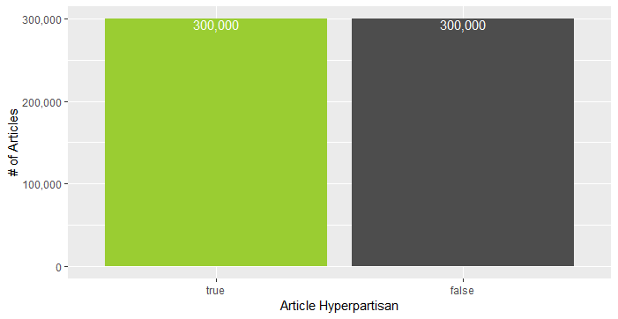
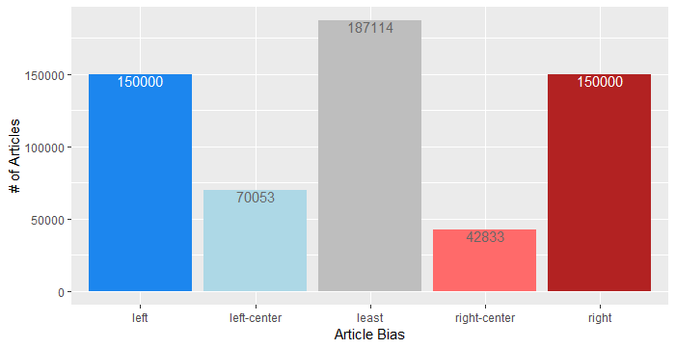
Exploratory Data Analysis (Train)
Predicting Political Lean in U.S. Political News Text | Spring 2019
Dataset
Conditioning
Quality
Exploratory Analysis
Data
Hyperpartisan | Left | Left Center | Center | Right Center | Right
False |  | 70,053 | 187,114 | 42,833
True | 150,000 |  |  |  | 150,000
Brinegar, Huang, Whalen, Wilbur, Zimmermann

Slide 52
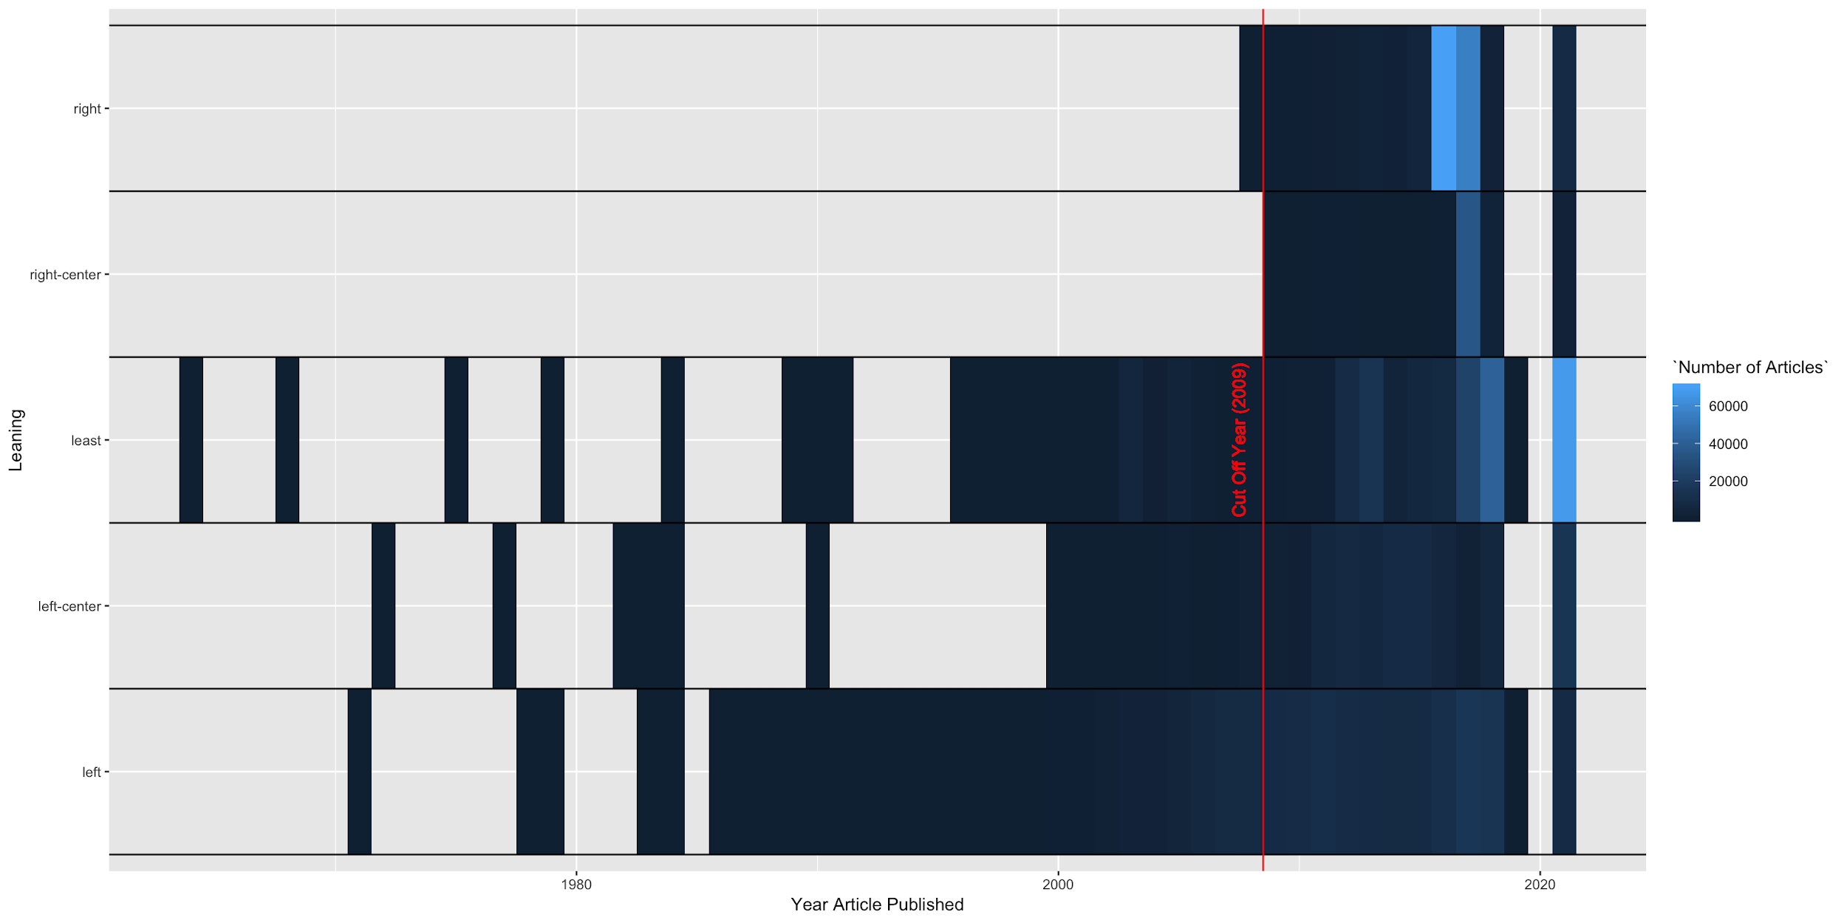
Exploratory Data Analysis (Train)
Predicting Political Lean in U.S. Political News Text | Spring 2019
Dataset
Conditioning
Quality
Exploratory Analysis
Data
Brinegar, Huang, Whalen, Wilbur, Zimmermann

Slide 53
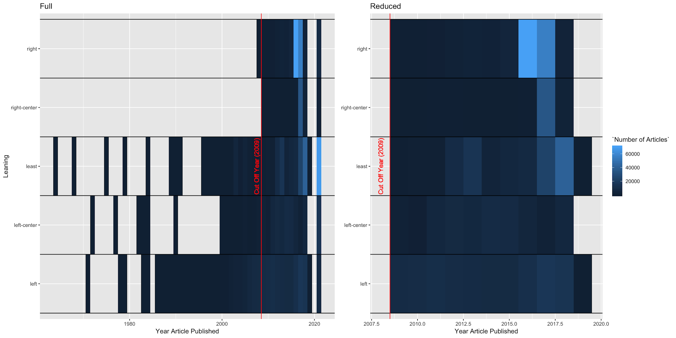
Exploratory Data Analysis (Train - Post Conditioning)
Predicting Political Lean in U.S. Political News Text | Spring 2019
Dataset
Conditioning
Quality
Exploratory Analysis
Data
Brinegar, Huang, Whalen, Wilbur, Zimmermann

Slide 54
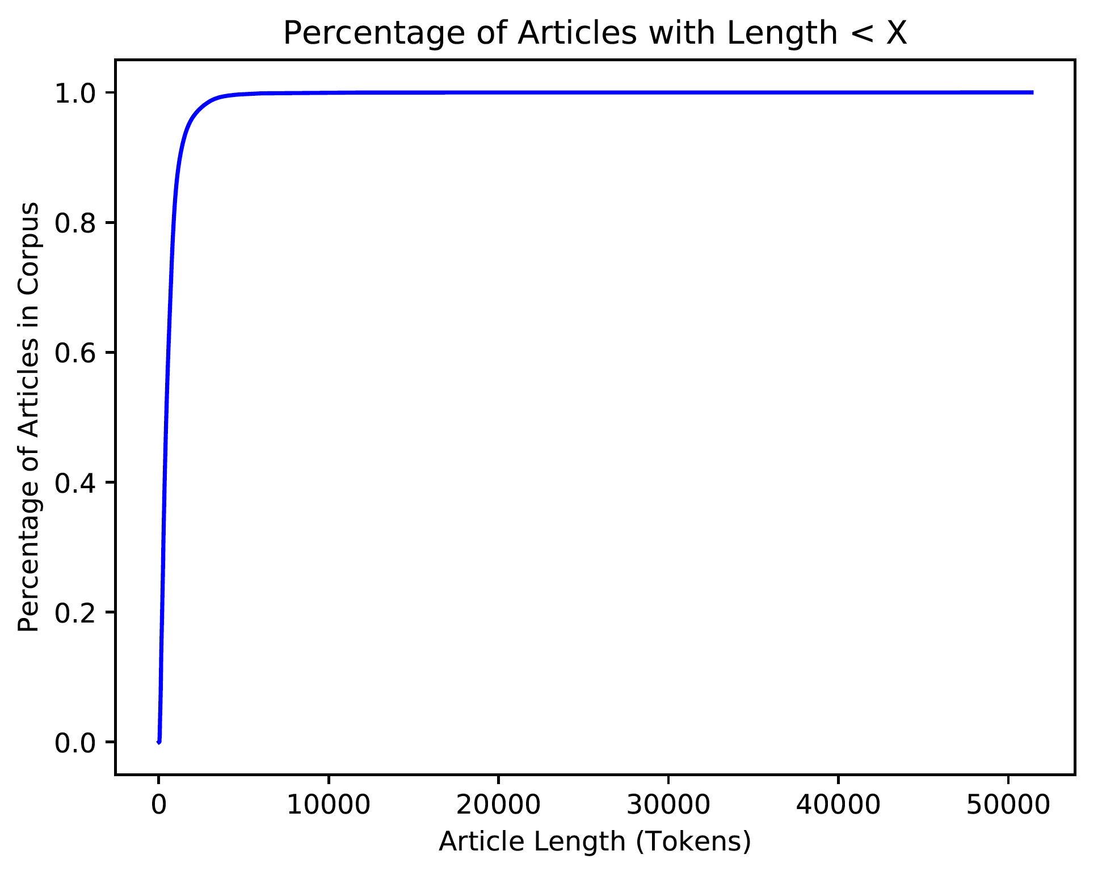
Exploratory Data Analysis (Train)
Predicting Political Lean in U.S. Political News Text | Spring 2019
Dataset
Conditioning
Quality
Exploratory Analysis
Data
Brinegar, Huang, Whalen, Wilbur, Zimmermann

Slide 55
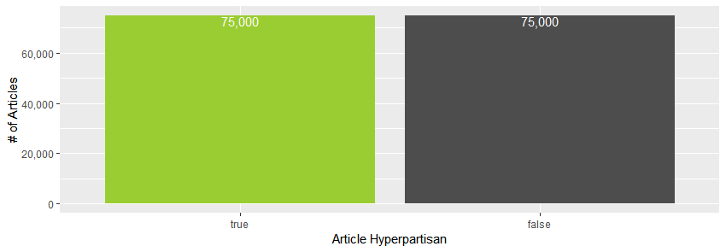
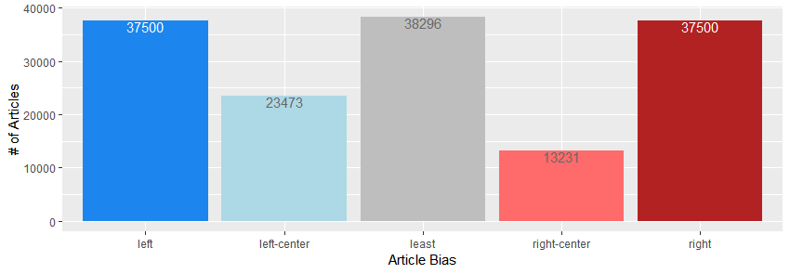
Exploratory Data Analysis (Test)
Predicting Political Lean in U.S. Political News Text | Spring 2019
Dataset
Conditioning
Quality
Exploratory Analysis
Data
Hyperpartisan | Left | Left Center | Center | Right Center | Right
False |  | 23,473 | 38,296 | 13,231
True | 37,500 |  |  |  | 37,500
Brinegar, Huang, Whalen, Wilbur, Zimmermann

Slide 56
Exploratory Data Analysis (Test)
Predicting Political Lean in U.S. Political News Text | Spring 2019
Dataset
Conditioning
Quality
Exploratory Analysis
Data
Brinegar, Huang, Whalen, Wilbur, Zimmermann

Slide 57
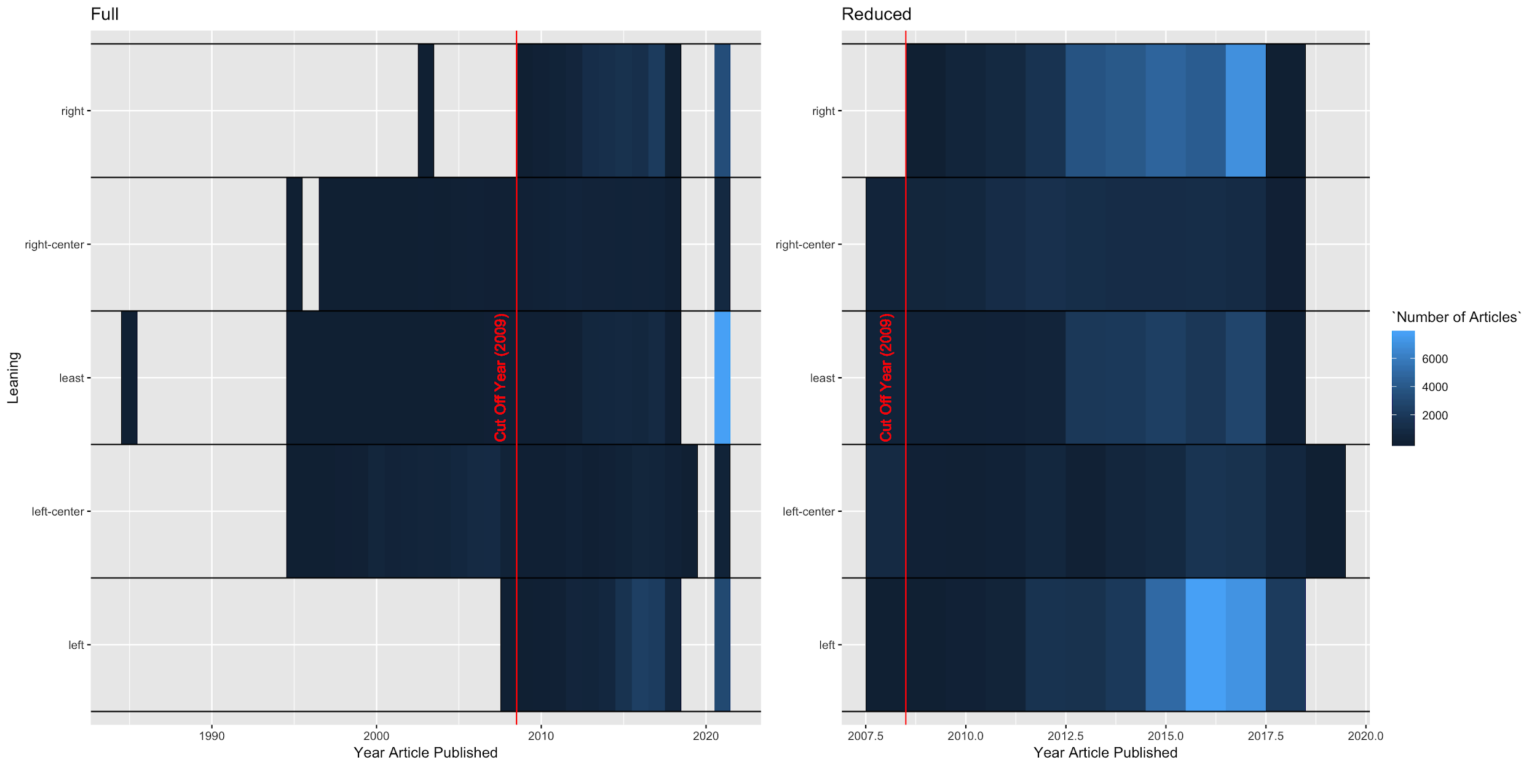
Exploratory Data Analysis (Test - Post Conditioning)
Predicting Political Lean in U.S. Political News Text | Spring 2019
Dataset
Conditioning
Quality
Exploratory Analysis
Data
Brinegar, Huang, Whalen, Wilbur, Zimmermann

Slide 58
Predicting Political Lean in U.S. Political News Text | Spring 2019
Neural Network
Processing Environ
Training Results
Test Results
Additional Analysis
Analysis
Word embedding via Global Vector (GloVE) is the input to our models. Word embedding translates each word in the text to a vector of some length. Vectors for words with similar meaning/context should have high cosine similarities.
Name | Dimension | Corpus | Vocabulary Size | Method | Language
glove.6B.50d | 50 | (6B) Wikipedia+Gigaword 5 | 400,000 | GloVE | English
“the” [ 0.42, 0.25, -0.41, 0.12, 0.35, -0.04, -0.50, -0.18, -0.00, -0.66, ...]
“quick” [ 0.14, -0.54, -0.18, -0.25, 0.16, -0.14, -0.25, 0.75, 0.27, 0.61, ...]
“brown” [-0.88, 0.72, -0.40, -0.11, 0.81, 1.03, -1.27, -0.49, -0.28, -0.92, ...]
“fox” [ 0.44, 0.06, 0.16, 0.93, 0.19, 0.24, -1.59, -0.80, -0.34, -0.24, ...]
Brinegar, Huang, Whalen, Wilbur, Zimmermann

Slide 59
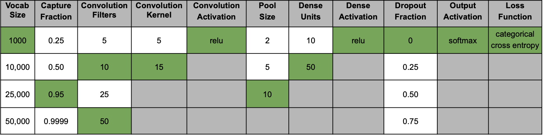
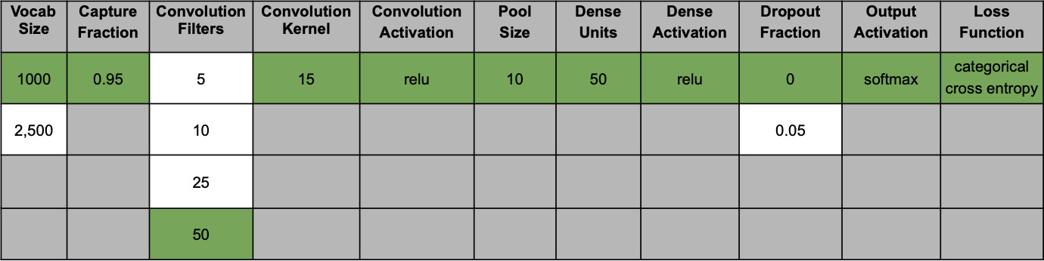
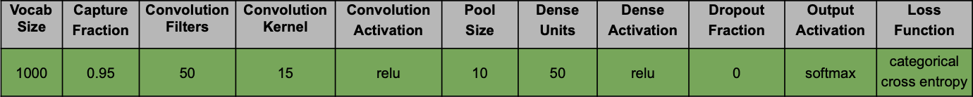
Predicting Political Lean in U.S. Political News Text | Spring 2019
Neural Network
Processing Environ
Training Results
Test Results
Additional Analysis
Analysis
CNN Tuning
Original Grid-Search
Refined Grid-Search
Final Model
Brinegar, Huang, Whalen, Wilbur, Zimmermann

Slide 60
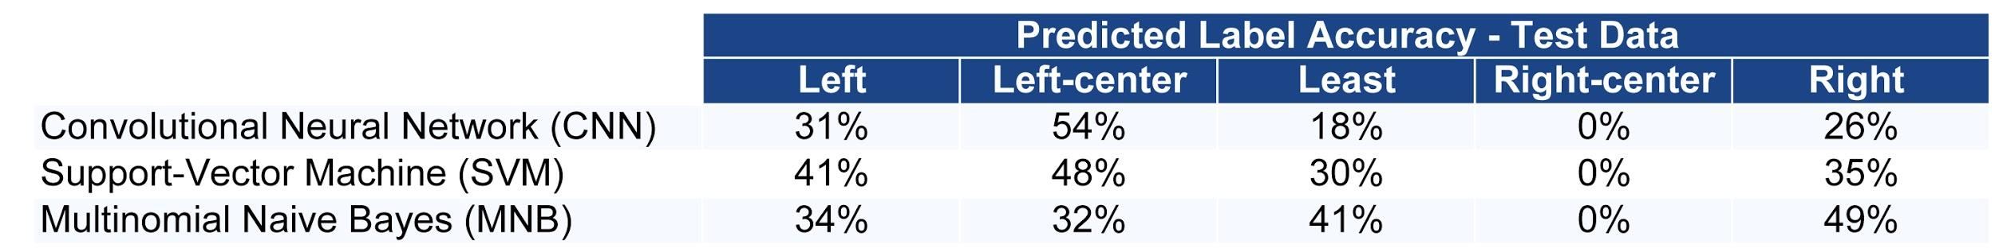
Predicting Political Lean in U.S. Political News Text | Spring 2019
Conclusions
Conclusions
Lessons Learned
Future work
Brinegar, Huang, Whalen, Wilbur, Zimmermann
Notes:
Summarize accuracies from CNN/MNB/SVM on dataset
Model did not generalize to the test set

